Slide 1
Introduction to Computer Science
Computer Software
Lecture c
This material (Comp 4 Unit 3) was developed by Oregon Health & Science University, funded by the Department of Health and Human Services, Office of the National Coordinator for Health Information Technology under Award Number 90WT0001.
This work is licensed under the Creative Commons Attribution-NonCommercial-ShareAlike 4.0 International License. To view a copy of this license, visit http://creativecommons.org/licenses/by-nc-sa/4.0/.
Notes:
Welcome to Introduction to Computer Science: Computer Software. This is lecture c.
The component, Introduction to Computer Science, provides a basic overview of computer architecture; data organization, representation, and structure; the structure of programming languages; and networking and data communication. It also includes some basic terminology from the world of computing.

Slide 2
Computer Software
Learning Objectives - 1
Define computer software and major software types (Lecture a)
Describe application software classification and provide examples, including those focused on health care (Lecture a)
Notes:
The learning objectives for this unit, Computer Software, are to:
Define computer software and major software types,
Describe application software classification and provide examples, including those focused on health care,

Slide 3
Computer Software
Learning Objectives - 2
Define what an operating system (OS) is (Lecture b)
Explain the features and functions of operating systems (Lecture b)
Classify operating systems (Lecture c)
Describe commonly used operating systems (Lecture c)
Notes:
Define what an operating system, or OS, is,
Explain the features and functions of operating systems,
Classify operating systems,
Describe commonly used operating systems,

Slide 4
Computer Software
Learning Objectives - 3
Describe types and major attributes of files (Lecture d)
Explain the purpose of file systems (Lecture d)
Provide file management tips (Lecture d)
Identify different implementations of file systems (Lecture d)
Notes:
Describe types and major attributes of files,
Explain the purpose of file systems,
Provide file management tips,
And, identify different implementations of file systems

Slide 5
Types of OSs
For personal computers
For servers
For handheld devices
For embedded computers
Notes:
This lecture classifies and describes commonly used operating systems.
All computers have an OS, and there are several types available. There are operating systems for personal computers, for servers, for handheld devices, and for embedded computers. All of them provide some level of the same core functionality, but differ in complexity and size.

Slide 6
Operating Systems for PCs - 1
DOS
Microsoft Windows
  Microsoft Windows 1.0 through 2000
  Microsoft Windows NT
  Microsoft Windows XP
  Microsoft Windows Vista
  Microsoft Windows 7
  Microsoft Windows 8
  Microsoft Windows 10
Notes:
For PCs, there are three main types of OSs available. The first is called simply Disk Operating System, or DOS. It is the command-line system for Intel chip PCs that pre-date Microsoft Windows.
The second is Microsoft Windows’ graphical user interface, or GUI-based OS for Intel chip-based PCs.
Version 1.0 was introduced in 1985 with subsequent versions 2, 3, and 3.1 being introduced throughout the following seven years.
Note that these initial versions of Windows were all based on DOS .
Windows 95 was introduced in 1995 and had an improved GUI.
Microsoft also released Windows versions 98, Millennium Edition or ME, and 2000.
In 1994, Microsoft developed and introduced their business OS, Windows NT.
In 2001, Windows XP combined the personal and business OS.
When it was introduced in 2007, Windows Vista introduced security features and changes to the user interface, or UI . Windows Vista was met with poor critical reception, and in 2009 Microsoft introduced Windows 7 which was primarily intended to be an incremental upgrade for Windows Vista.
Windows 8 was released in 2012 and introduced some changes, including a touch-optimized Windows shell.
Windows 10, the latest version, was released in 2015.

Slide 7
Operating Systems for PCs - 2
Mac OS
  Classic Mac OS -Mac OS 9
  Mac OS X 10.1-10.4
  Mac OS X 10.5 (Leopard)
  Mac OS X 10.6 (Snow Leopard)
  Mac OS X 10.7 (Lion)
  Mac OS X 10.8 (Mountain Lion)
  Mac OS X 10.9 (Mavericks)
  Mac OS X 10.10 (Yosemite)
  Mac OS X 10.11 (El Capitan)
Notes:
The third type of OS, Mac OS, works on Apple Macintosh personal computers, which have ranged from the classic Mac OS first introduced in 1984 through version 9 in 2001. The hallmark of the Mac OS was its completely graphical user interface—it never used a command line like DOS.
Mac OS X is a completely different OS—it is a BSD UNIX OS, which makes it very secure and stable. It was first introduced in 2002 and has had six additional significant versions since then, including the Snow Leopard version, version 10.6, which uses a graphical interface called Aqua. The latest version, OS X El Capitan, was released in 2015.

Slide 8
Operating Systems for PCs - 3
Linux
  Unix-like operating system
  Released in 1991 by Linus Torvalds
  Free and open-source software
  Interface either through command-line interface (CLI), or a graphical user interface (GUI)
  Some of the popular desktop environments: K Desktop Environment (KDE), GNOME, Pantheon, Cinnamon, Unity
Notes:
Linux is a Unix-like operating system released in 1991 by Linus Torvalds. The name "Linux" comes from combining "Unix" and "Linus". It is a free and open-source software. The user can interface with Linux either using a command-line interface, or CLI, or a graphical user interface, or GUI. Some of the popular desktop environments are the K Desktop Environment or KDE, GNOME, Pantheon, Cinnamon, and Unity.

Slide 9
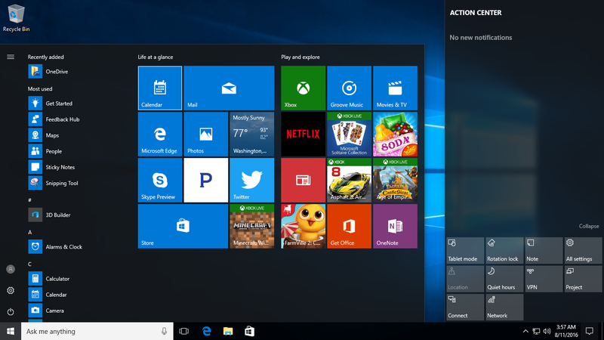
Microsoft Windows 10
(Damjan4evski/Microsoft, 2016. CC BY-SA 4.0)
Notes:
This is a screen shot of Windows 10. As of 2016, Windows 10 is the latest release of Microsoft Windows.

Slide 10
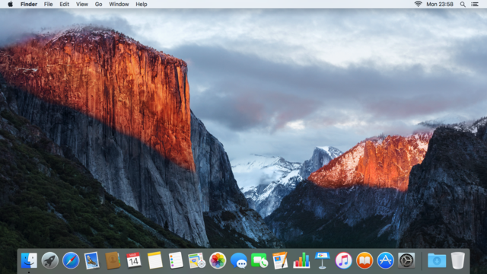
OS X El Capitan
(As11ley/Apple Inc, 2016, Fair Use/Wikipedia non-free content.)
Notes:
This is a screenshot of Mac’s OS X El Capitan showing the Aqua graphical interface.

Slide 11
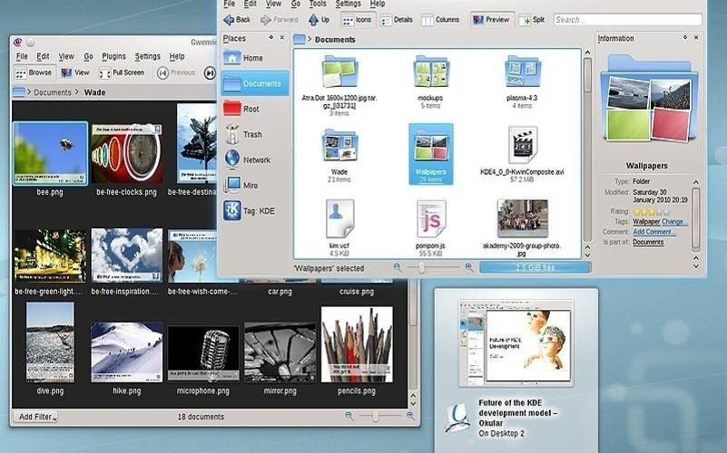
Linux
(KDE 4 Desktop Environment)
(KDE ® /KAMiKAZOW, 2011, GNU-GPL)
Notes:
This is Linux running the KDE 4 Desktop environment.

Slide 12
Microsoft Windows vs. Mac OS X
Strengths of MS Windows
  Most applications available for MS Windows®
  Large variety of hardware that runs MS Windows
Weaknesses of MS Windows
  Poor reliability
  Vulnerable security
Strengths of Mac OS X
  User friendly
  Reliable
  Secure
Weaknesses of Mac OS X
  Limited application software availability
Notes:
When comparing Windows versus Mac OS X, the biggest strength for the Windows OS is the large number of applications available, as well as all of the compatible hardware and devices. Conversely, the weakness of Mac OS X is the limited application software availability; some software is simply not available for Mac OS X.
A big benefit of Mac OS X is that it is easy to use, although the Windows 10 GUI is now quite similar to Mac OS X.
Because Mac OS X is based on UNIX, it is highly reliable and secure. On the other hand, Windows is not as reliable and secure. Software running in Windows often freezes up or ends suddenly, unlike with Mac OS X, where this is a rarity.
Also, far more malware targets Windows platforms than Mac OS X. Part of the reason is that Windows’ use is much more widespread than MAC OS X, making Windows a bigger target. The other part of the reason is that the Windows OS is not as secure as Mac OS X.

Slide 13
OS for PCs and Servers
Unix
  Developed in 1969
  Used for mainframes
  Many different variations available
Linux
  Open source version of Unix created by Linus Torvalds in 1991
Notes:
UNIX is an OS developed in 1969 for mainframes. It is still used today in many different variations and versions. It is very robust, secure, and stable.
In 1991, Linus Torvalds created Linux, which is a free, open-source version of UNIX. Both Linux and UNIX can be installed on both PCs and workstations as well as large servers and mainframes.

Slide 14
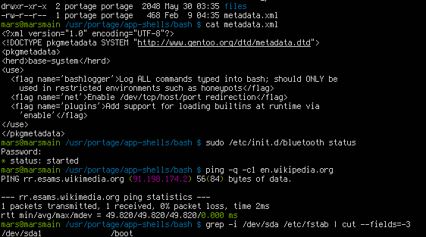
UNIX
(Emx, 2006, GNU-GPL)
Notes:
These are the command lines in a UNIX system. Windowing environments are available for UNIX, but the command line remains available.

Slide 15
OSs for Servers
Mac OS X Server
Microsoft Windows Server
  Versions 2008, 2008 R2, 2012, 2012 R2, 2016
  Windows High Performance Computing (HPC) Server 2008, 2008 R2, 2012, 2012 R2
Windows Small Business Server
Windows Essential Small Business Server
Windows Home Server
Unix/Linux
Notes:
There are many OS options available for servers. Mac OS X Server is identical to OS X for PCs, it just adds functionality needed for servers.
Microsoft Windows Server was introduced to follow Windows NT for large server applications. Since then, there have been several versions released, with the latest being Windows Server 2016.
Additionally, there are server OSs (oh-esses) designed specifically for high performance computing: HPC Server 2008, 2008 R2, 2012, and 2012 R2. On the smaller side, there are server operating systems for small businesses, medium-sized businesses, and home use. Finally, UNIX and Linux can be used as an OS for a server.

Slide 16
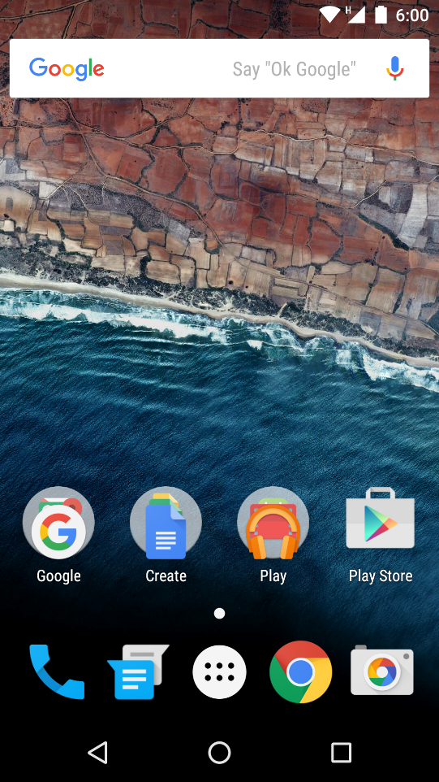
OSs for Handheld Devices
Microsoft Windows 10 Mobile
iPhone iOS 4
Android™ OS
Blackberry® OS
(NikoM/Android Open Source Project, 2017. Apache License 2.0)
Notes:
Operating systems for handhelds are smaller and simpler than for PCs. The OS on a hand-held is so small it can be stored in ROM and loaded immediately when the device is turned on. The OS provides built-in support for touch screens, handwriting input, wireless networks, and cellular communication. Some examples include Microsoft Windows 10 Mobile OS for phones; iPhone iOS 9, based on Mac OS X for iPhones; Blackberry OS for Blackberries; and the Android OS, which is based on Linux for Android phones.

Slide 17
OS for Embedded Systems - 1
An embedded system is a special-purpose computer encapsulated in a larger system
Embedded systems need their own OS
Some are proprietary and developed for specific hardware system alone
Notes:
An embedded system is a special-purpose computer encapsulated in a larger mechanical or electrical system.
There are embedded computers in everything from home appliances to power-steering modules to home electronics. These systems still need their own operating system. Some operating systems are developed specifically for those devices and are proprietary.

Slide 18
OS for Embedded Systems - 2
Some are commercially available and customizable
  Windows Embedded 7: Built on Windows 7
  Windows Embedded Compact: For small-footprint devices
  Windows Embedded 8: The latest (2016) release of Windows Embedded products
Notes:
Some embedded systems are commercially available and customizable. Microsoft offers a family of embedded operating systems based on Windows. Among those currently used in 2016 are: Windows Embedded 7, Windows Embedded Compact, and Windows Embedded 8.

Slide 19
Embedded OS Example
M-Turbo® ultrasound system by SonoSite, Inc. runs Windows Embedded CE
  Handheld
  Easy to use
  Boots in less than 15 seconds
  Instant images
Notes:
M-Turbo is an example of a medical device that uses an embedded OS. In this case, it uses Windows Embedded CE, which is another type of embedded OS from Microsoft. This hand-held, portable ultrasound device boots quickly and provides instant ultrasound images that can be transferred to a computer using USB technology.

Slide 20
Computer Software
Summary - Lecture c
Classify operating systems
Describe commonly used operating systems
Notes:
This concludes Lecture c of the unit on Computer Software. In summary, this lecture classified and described some of the more common operating systems, including the features and benefits of several of them.

Slide 21
Computer Software
References – 1 – Lecture C
References
Evans A, Martin K, Poatsey MA. (2010). Chapter 5: Using System Software: The Operating System, Utility Programs and File Management. In: Technology in Action: Complete. 7th ed. New Jersey: Prentice Hall.
KDE. [Webpage]. [updated 2011 Nov 12; cited 2011 Nov 12]. Available from: http://www.kde.org.
The Linux Foundation. [Webpage]. [updated 2011 Nov 12; cited 2011 Nov 12]. Available from: http://www.linuxfoundation.org.
Microsoft Windows. [Webpage]. [updated 2011 Nov 9; cited 2011 Nov 12]. Available from: http://windows.microsoft.com/en-US/windows/home.
Morley Deborah, Parker Charles S. (2010). Chapter 6: System Software: Operating Systems and Utility Programs. In: Understanding Computers Today and Tomorrow. 12th ed. Boston: Course Technology.
OS X. [Webpage]. [updated 2011 Nov 12; cited 2011 Nov 12]. Available from: http://www.apple.com/macosx/.
Notes:
References slide. No audio.

Slide 22
Computer Software
References – 2 – Lecture C
References
Parsons JJ, Oja D. (2010). Chapter 4: Operating Systems and File Management. In: New Perspectives on Computer Concepts 2011: Comprehensive. 13th ed. Boston: Course Technology.
Shelley GB, Vermaat ME. (2010). Chapter 8: Operating Systems and Utility Programs. In: Discovering Computers 2011: Introductory. 1st ed. Boston: Course Technology.
M-Turbo ultrasound system [Webpage]. Fujifilm SonoSite. Accessed February 24, 2017 from https://www.sonosite.com/product/sonosite-m-turbo.
The Unix System Homepage. [Webpage]. [updated 2011 Nov 12; cited 2011 Nov 12]; Available from: http://opengroup.org/unix.
Why booting is called booting. (2012, March 11). Retrieved May 1, 2016, from http://desktopreality.com/why-booting-is-called-booting/.
Windows Embedded Web site. [Webpage]. [2015, cited 2016 Mar 07]; Available from: https://www.microsoft.com/windowsembedded/en-us/products-solutions-overview.aspx.
Notes:
References slide. No audio.

Slide 23
Computer Software
References – 3 – Lecture C
Images
Slide 9: A screenshot of Microsoft Windows 10. [image on the Internet]. Microsoft [software] and Damjan4evski [image]. (2016, August 20). Retrieved February 24, 2017 from https://commons.wikimedia.org/wiki/File:Windows_10_mk.png. Licensed under the Creative Commons Creative Commons Attribution-Share Alike 4.0 International License.
Slide 10: A screenshot of Mac OS X 10.11 El Capitan default desktop. [image on the Internet]. Apple, Inc [software] and User: As11ley [image]. (2016, March 15). Retrieved February 24, 2017 from https://en.wikipedia.org/wiki/File:OS_X_El_Capitan_screenshot.png. Fair Use exception, Wikipedia Fair Use as non-free content.
Slide 11: A screenshot of KDE Plasma Desktop 4.4. [image on the Internet]. KDE [software] and User: KAMiKAZOW [image]. (2010, February 9). Retrieved from https://commons.wikimedia.org/wiki/File:Plasma_Desktop_4.4.jpg. Licensed under the GNU General Public License.
Slide 14: A screenshot of Bourne Again SHell (BASH). [image on the Internet]. GNU [software], User: Emx [original image], and User: Iketsi [updated image]. (2013, April 18). Retrieved February 24, 2017 from https://commons.wikimedia.org/wiki/File:Bash_screenshot.png. Licensed under the GNU General Public License.
Slide 16: Android OS 6.0 home screen. [image on the Internet]. Android Open Source Project [software], User: Adrianwo [original image], and User: NikoM [updated image]. (2016, January 29). Retrieved February 24, 2017 from https://commons.wikimedia.org/wiki/File:Android_6.0-en.png. Licensed under the Apache License Version 2.0.
Notes:
References slide. No audio.

Slide 24
Introduction to Computer Science
Computer Software
Lecture C
This material was developed by Oregon Health & Science University, funded by the Department of Health and Human Services, Office of the National Coordinator for Health Information Technology under Award Number 90WT0001.
Notes:
No audio.

