Slide 1
History of Health Information Technology in the U.S.
History of Electronic Health Records (EHRs)
Lecture b – Evolution of Functional
Requirements for EHRs
This material (Comp 5 Unit 6) was developed by the University of Alabama at Birmingham, funded by the Department of Health and Human Services, Office of the National Coordinator for Health Information Technology under Award Number 90WT0007.
This work is licensed under the Creative Commons Attribution-NonCommercial-ShareAlike 4.0 International License. To view a copy of this license, visit http://creativecommons.org.
Notes:
Welcome to History of Health Information Technology in the US, History of Electronic Health Records. This is lecture b, Evolution of Functional Requirements for EHRs. This lecture will describe some of the features that are desirable in an EHR.

Slide 2
History of Electronic Health Records Learning Objectives
Describe some early examples of electronic medical records
Discuss lessons learned from the early EHR implementations
Discuss how the attributes that were identified for a computer-based patient record in the 1991 Institute of Medicine report relate to the concept of meaningful use
Discuss differences between the terms electronic health record (EHR) and personal health record (PHR)
Notes:
The Objectives for this unit, History of Electronic Health Records are to:
Describe some early examples of electronic medical records.
Discuss lessons learned from the early EHR implementations.
Discuss how the attributes that were identified for a computer-based patient record in the 1991 Institute of Medicine Report relate to the concept of meaningful use.
Discuss differences between the terms electronic health record (EHR) and personal health record (PHR).

Slide 3
IOM Criteria for CPR
The Computer-Based Patient Record
1991
Criteria for CPR
Source: (Dick, et al.,1991)
Notes:
The Institute of Medicine, or I-O-M, is a non-profit national advisory group on health matters. Its members are selected from leading experts in the country.
In 1991, the IOM released a book entitled The Computer-Based Patient Record. In that book (published by the National Academy Press), the gold standard criteria or attributes for a computer-based patient record or C-P-R were described. We will use the term CPR when referring to these older Institute of Medicine criteria, because we will also discuss the standards for an electronic health record that the IOM subsequently developed in the summer of 2003.

Slide 4
IOM Criteria for CPR 2
The Computer-Based Patient Record
Two editions: 1991 and 1997
Recommendations for CPR
Gold standard
Vendor community
Source: (Dick, et al., 1997)
Notes:
Both the 1991 first edition of The Computer-based Patient Record, and the second edition of 1997, offered recommendations that remain today as the gold standard for features that should be incorporated into electronic health records. In fact, they also underlie the more recent recommendations for a good electronic health record.
Finally, in part because of the desire for purchasing systems that will support meaningful use of electronic health records, there is more interest in the vendor community in incorporating these attributes. So let's take a look at them.

Slide 5
IOM Criteria for CPR 3
Problem list
Notes:
The first essential attribute of a CPR is it should support a problem list that is able to be linked to orders and results, so that the logic of the relationship of orders to problems is clear.
There are many aspects of the clinical record that relate to the problem list. The physician may record the patient’s primary problem or chief complaint in the patient’s own words, or may record the patient’s final diagnosis for the given encounter using standard terminology. While these relate to the problem list, the problem list itself is a regularly updated description of all the patient’s problems, including new, active or chronic conditions and historical or resolved problems. The problems are worded in whatever way the available data can support. So if a patient comes in with chest pain, until there are data to support a diagnosis of heart attack, the problem may be listed as chest pain.

Slide 6
IOM Criteria for CPR 4
Health status measures
Notes:
There also should be a place to record health status measures. These measures include the patient’s ability to function in daily life. For instance, they might include anything from a patient’s mobility, to the patient’s ability to work, to any evidence of depression, in addition to specific outcomes related to a patient’s particular medical condition.
Recording these health status measures will facilitate the linkages of process and outcome measures. Currently, these patient-reported outcome measures are not routinely recorded in the medical record. This may be an example of the technology push idea: if the technology provides a mechanism for recording the data, maybe it will be more frequently recorded.

Slide 7
IOM Criteria for CPR 5
Rationale for decision making
Notes:
There should be a place to record the rationale for decisions. This rationale may also be linked to clinical guidelines. For instance, a laboratory test may be ordered because the doctor wants to make sure the patient doesn’t have a particular disease. This is known as ruling out the disease and there should be a place to indicate that ruling out the particular disease is the reason for ordering the lab test.

Slide 8
IOM Criteria for CPR 6
Records integration
Other settings
Other time periods
Notes:
One of most important aspects of a CPR is that it should be able to be integrated with other records. For example, records from other settings should be integrated with the current record. The outpatient and inpatient records, or generalist and specialty clinic records or records over time, should all be connected, so that the record can truly be a lifetime medical record.

Slide 9
IOM Criteria for CPR 7
Protection of confidentiality
Notes:
Obviously, mechanisms for protecting confidentiality of information should be included. Tracking with audit trails of who has accessed the record needs to be included. These are now part of the HIPAA requirements and were recently strengthened as part of the HITECH act.

Slide 10
IOM Criteria for CPR 8
Timely access
Simultaneous
Remote
Notes:
Timely access, both on site and remotely, and with multiple simultaneous users, needs to be assured. At the same time, unauthorized updates need to be prevented.

Slide 11
IOM Criteria for CPR 9
Tailored views
Notes:
In addition, tailored views are necessary. This means that different specialties, departments and even individual users can configure the system to customize the information and format that is presented to them. If you remember, that ability to customize to meet user’s needs was one of the characteristics of several of the early electronic systems.

Slide 12
IOM Criteria for CPR 10
Access to local and remote databases
Medical literature
Clinical guidelines
Source: (Miller, et al., 2005)
Notes:
The CPR should be able to provide easy access to both local and remote databases. These may be things like the medical literature database MEDLINE, or national or local clinical guidelines.
For instance, medical informaticians at Vanderbilt University have developed point and click, context sensitive, links to MEDLINE or drug information databases. This system has been incorporated commercially in some of the McKesson (pronounced Mick-Kesson (like lesson)) clinical systems.

Slide 13
IOM Criteria for CPR 11
Clinical problem solving assistance
Decision support tools
Notes:
The CPR should assist and guide clinical problem solving by incorporating decision support tools. These might include a variety of tools including reminders, alerts and other decision support tools. Again, this recommendation did not come out of the blue, but reflected the functionality of some of the early systems.

Slide 14
IOM Criteria for CPR 12
Structured data entry by physicians
Defined vocabulary
Notes:
Not only should the CPR support direct entry of data by physicians, but it should also support structured data entry. This means there needs to be a defined vocabulary to describe what each element of the record means. This may not have to be an input vocabulary, but the database that underlies the record should be structured, even if physicians dictate using natural language. What may then be needed is a mechanism to link from the dictated language to the structured language. As you can imagine, this is not an always an easy task.

Slide 15
IOM Criteria for CPR 13
Assessment
Quality and cost
Notes:
The CPR should be structured in such a way that it can support assessment of both quality and cost measures. Some of the other attributes, such as including functional and other outcomes measures, are part of this. Linking to cost data also needs to be part of this attribute.

Slide 16
IOM Criteria for CPR 14
Flexible and expandable
Notes:
And finally, if all this isn’t enough, the system also needs to be flexible and expandable so that it can support evolving needs.
It is obvious from this list that few systems are fully functional in all of these aspects.

Slide 17
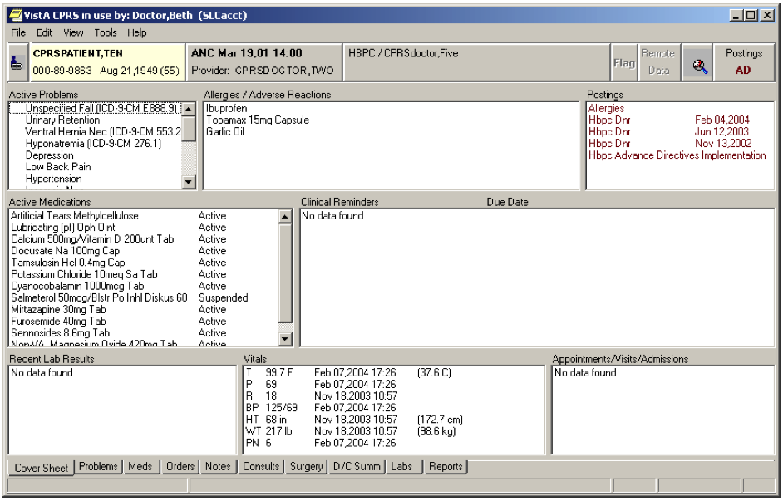
Cover Sheet of VISTA EHR
Notes:
This is a picture of what the clinician will see in the EHR used in the Veterans’ Administration Hospitals, otherwise known as the VA (pronounced V-A). This EHR is known as Vista. As you can see, it embodies many of the criteria we just discussed. There is a problem list in the upper left corner. There is a place for decision support in the section on clinical reminders in the middle, and the vital signs are recorded in structured form.

Slide 18
Electronic Health Record System Capabilities
IOM Committee on Data Standards – 2003
CPR versus EHR
EHR assumes involvement of patients
Source: (Institute of Medicine, 2003)
Notes:
In 2003, the IOM’s Committee on Data Standards for Patient Safety issued what was termed a “letter report,” in which some of the key functional features proposed for an electronic health record, or EHR, were identified.
One of the differences between the criteria for the CPR and the EHR is that the EHR assumes that there will be involvement and communication with and from patients as well as healthcare providers. Let’s look at some of the proposed capabilities of the EHR.

Slide 19
Electronic Health Record System Capabilities 2
Direct care functions
Supportive functions
Information infrastructure
Notes:
The functions of an optimal EHR are divided into three areas: functions relating to direct care of the patient, those relating to supporting care, and the functions relating to the information infrastructure that underlies the EHR.

Slide 20
Electronic Health Record System Capabilities 3
Direct care functions
Care management
Clinical decision support
Operations management and communication
Notes:
The direct care functions include all the functions relating directly to care management. Capturing all necessary patient information, managing orders for the patient, managing results reporting, referrals, etcetera, are all care management functions.
Clinical decision support includes functions which inform the direct care of patients. Protocols, guidelines, drug interaction checking, alerts, reminders, and so forth, fall into this category. Because the EHR should include patient involvement, clinical decision support functions also include functions for the management of patient preferences, self-care and other functions related to the patient.
Operations management and reporting include functions related to scheduling and communication among providers, as well as between provider and patient. It also includes more automated communication such as communication with medical devices.

Slide 21
Electronic Health Record System Capabilities 4
Supportive functions
Clinical support (e.g., demographics)
Measurement, analysis, research, reporting
Administrative and financial
Notes:
Support functions of an EHR include functions to support direct clinical care, such as patient and provider demographic information. This might include age, race, gender, etcetera, scheduling and bed assignments, etcetera, as well as functions related to analytic, administrative and financial activities. What this would allow is tighter integration of the clinical data with the financial and administrative data. In turn, it would provide more capabilities for quality improvement and similar activities.

Slide 22
Electronic Health Record System Capabilities 5
Information Infrastructure Functions
Security
Records management
Unique identity, registry and directory services
Health informatics and terminology standards
Interoperability
Management of business rules
Workflow
Notes:
The final set of functions relate to the technical underpinning of the EHR. This will include security issues, as well as standards for vocabulary, and other interoperability standards so that different systems within and between organizations can talk to each other.
These recommendations underlie some of the current recommendations for meaningful use of EHRs.

Slide 23
Meaningful Use
Major current recommendations
Computerized Provider Order Entry (CPOE)
Clinical Decision Support (CDS)
Electronic Prescribing (E-prescribing)
Structured documentation of quality measures
Up-to-date problem lists and diagnoses
Providing patients with health information electronically
Information exchange
Notes:
The HITECH act of 2009 has established policy and standards committees to make recommendations for EHRs. These meaningful use standards will evolve over time, but there are certain key elements that are included and these will become part of the certification standards for EHRs as well.
Requirements for clinical decision support, structured capture of quality measures, up-to-date problem lists, and information exchange are very similar to those recommendations from the IOM report of nearly twenty years ago and the infrastructure standards are likely to echo the 2003 report in many ways.
The HITECH recommendations are also similar to the functionalities of many of the early systems that came even before the original IOM report.

Slide 24
EHR Adoption
Increased dramatically since 2009
In 2014, 97% of hospitals used certified EHR technology(CEHRT)
In 2014, 74% of physicians used CEHRT
76% of hospitals and 51% of physicians used basic EHR functions in 2014
Sources Charles et al., 2015.
Heisey-Grove & Patel, 2015
Notes:
Since the Meaningful Use regulations came out, the use of Certified EHR technology has increased tremendously. As of 2014, 97% of hospitals and 74% of physicians had adopted an EHR. Most of the functions of what constitutes a basic EHR are routinely used. These functions include the ability to record electronically patient demographics, problem lists, medication lists, and discharge summaries as well as use computerized provider order entry for at least medications and to view lab, radiology, and diagnostic test results. A sizable number of providers are also using other functions, such as using CPOE for other types of orders and employing clinical decision support, which are included in what is known as a comprehensive EHR.

Slide 25
History of Electronic Health Records (EHRs) Summary
1991 IOM report still the gold standard
Most systems today still do not meet all of the IOM criteria
Early systems met many of the criteria
Broader development of EHRs with HITECH
Notes:
This concludes History of Electronic Health Records.
In summary, if we look back over the evolution of electronic health records, we see that the 1991 IOM (pronounced I-O-M) report on the computer-based patient record is still the gold standard for EHR functionality today. Unfortunately, this is a standard that most of today’s systems still don't meet. Yet, over thirty years ago, there were EHR systems that met at least some of these standards. Despite these examples, and the IOM recommendations, it has taken the 2009 HITECH act to finally spur broader development and use of EHRs.

Slide 26
Acknowledgment
Some of the material in this presentation is also included in the following book and is used with permission:
Smaltz DH, Berner ES. The executive’s guide to electronic health records. Chicago IL: Health Administration Press; 2007.
Notes:
“No Audio”

Slide 27
History of Electronic Health Records References – Lecture b
References
Dick RS, Steen EB, Detmer DE. The computer-based patient record: an essential technology for healthcare. Revised Edition. Washington, DC: National Academy Press; 1997.
Institute of Medicine. Committee on Data Standards for Patient Safety, Board of Health Care Services. Key capabilities of an electronic health record system. Letter report. Washington (DC): The National Academies Press; 2003 Jul.
Miller RA, Waitman LR, Chen S, Rosenbloom ST. The anatomy of decision support during inpatient care provider order entry (CPOE): empirical observations from a decade of CPOE experience at Vanderbilt. J Biomed Inform. 2005 Dec;38(6):469-85.
Smaltz DH, Berner ES. The executive’s guide to electronic health records. Chicago (IL): Health Administration Press; 2007.
Charles D, Gabriel M, Searcy T. Adoption of Electronic Health Record Systems among U.S. Non-Federal Acute Care Hospitals: 2008-2014. ONC Data Brief, No.23. Office of the National Coordinator for Health Information Technology: Washington DC., April 2015. www.healthit.gov Accessed May 21,2016.
Heisey-Grove D, Patel V. Any, Certified, or Basic: Quantifying Physician EHR Adoption. ONC Data Brief, No. 28. Office of the National Coordinator for Health Information Technology: Washington DC.,, September 2015. www.healthit.gov . Accessed May 21, 2016
Images
Slide 17: Available from: www.va.gov
Notes:
“No Audio”

Slide 28
History of HIT in the US History of Electronic Health Records Lecture b
This material was developed by the University of Alabama at Birmingham, funded by the Department of Health and Human Services, Office of the National Coordinator for Health Information Technology under Award Number 90WT0007.
Notes:
No Audio.

