Slide 1
History of Health Information Technology in the U.S.
History of Health Information Exchange
This material (Comp 5 Unit 9) was developed by the University of Alabama at Birmingham, funded by the Department of Health and Human Services, Office of the National Coordinator for Health Information Technology under Award Number 90WT0007.
This work is licensed under the Creative Commons Attribution-NonCommercial-ShareAlike 4.0 International License. To view a copy of this license, visit http://creativecommons.org.
Notes:
Welcome to History of Health Information Technology in the U.S., History of Health Information Exchange. This lecture focuses on Health Information Exchange by outlining the history of US-based attempts at getting health information exchanged among providers. By understanding the history presented, you will be able to better understand some of the current challenges and to envision ways to overcome them.

Slide 2
History of Health Information Exchange Learning Objectives
Describe historical US efforts at realizing health information exchange
Define community health information networks (CHINs) and regional health information organizations (RHIOs)
Describe why CHINs failed in the 1990s
Describe the concept of RHIOs and articulate how they relate to other efforts at health information exchange
Notes:
The Objectives for this unit, History of Health Information Exchange are to:
Describe historical US efforts at realizing health information exchange.
Define community health information networks or CHINs (pronounced chins) and regional health information organizations known as RHIOs. (pronounced REE-ohs like the plural of rio grande)
Describe why CHINs failed in the 1990s.
Describe the concept of RHIOs and articulate how they relate to other efforts at health information exchange

Slide 3

Dilemma
How does the emergency doctor in California access your EHR-based medical information (located in New York) while you are on vacation and need care?
Photo by Christian Mehlfuhrer
Notes:
The fundamental need underlying the justification for health information exchange is depicted in the following scenario. Imagine you are vacationing across the country. Say you’re from New York and you’re in California and are rushed to the hospital following an unfortunate car accident.
The doctor who treats you in California would greatly benefit from knowing more about your underlying health conditions, prior diseases you may have had, or chronic diseases that you have, what allergies to medications you have, and what drugs you’re currently on.
Even if all of this information was securely stored in an electronic health record system in your primary care physician’s office in New York, there still needs to be a mechanism by which the California-based physician can access this information in order to provide you the highest quality of care.

Slide 4
The Challenge
Where is a patient’s data stored?
  At primary care physician’s office
  At various specialist physician offices
  At several pharmacies
  At several hospitals, including emergency departments
Notes:
This problem is compounded by the fact that patients typically have data stored in more than one location, not just at their primary care physician’s office. They may be cared for by a variety of other physician specialists. For example, they may have data from medication prescriptions stored at one or more pharmacies. They perhaps have had experiences at different hospitals, including emergency departments, that ultimately result in medical records being produced.

Slide 5
The Challenge 2
Over a lifetime, much data accumulates and is stored in “silos”
  Healthcare data is usually not directly available by others who may need access
Notes:
Over a lifetime, much data accumulates at a variety of different places. These separate sources of information are often referred to as silos, like the grain silos that stand tall and isolated from each other. Now, individual providers caring for the same patient even in a given neighborhood, perhaps even across the street from each other, as we’ll see in just a second, cannot easily access each other’s data. Currently, they rely on the faxing or mailing of pertinent information (usually when it’s directly requested), which makes it difficult to access needed information in “real time,” like in the example of the vacationer from New York who had an accident in California.

Slide 6
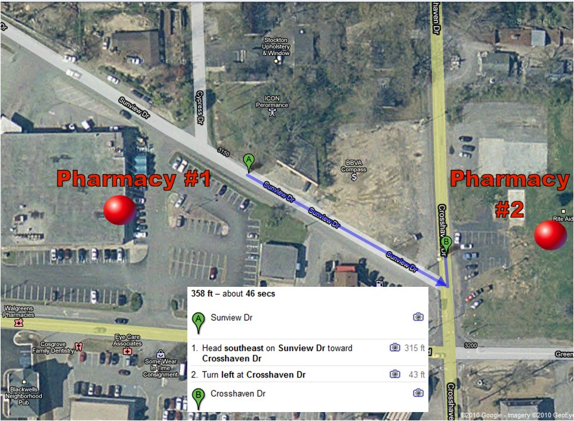
So Close…
Notes:
Here is a map view of two competing pharmacies in the same neighborhood. As can be seen in the Google Maps photo, the two pharmacies are several hundred feet apart from each other -- practically across the street from one another.
Currently, there is no infrastructure in place to transfer a prescription from one pharmacy to the other. That is, if you’re the patient, and you want to transfer a prescription you have at one of these pharmacies, to the other, there is no mechanism to “beam” that prescription, if you will, from one place to the other.
Certainly, it is possible within a pharmacy that belongs to a national chain to get a prescription transferred to another pharmacy of that same chain, but it is not currently possible to transfer between pharmacies in different chains.
The same is true for all other healthcare organizations -- whether pharmacies, or doctors’ offices or hospitals. The unfortunate truth is data are not easily exchanged from one place to the other; even hospitals that belong to the same national chains, in most cases, cannot transfer information about patients from one location to another.

Slide 7
Health Information
Exchange (HIE)
HIE is the process of sharing patient-level electronic health information (for example: lab results, medication lists) between different organizations (for example: hospitals, physician offices, pharmacies)
Much of the exchange occurs locally (within a given community)
Many instances also require HIE across community or state boundaries
Notes:
So, in terms of a definition, the National Alliance for Health Information Technology defined Health Information Exchange, or HIE (pronounced H-I-E), as the process of sharing patient-level electronic health information, such as lab results, or medication lists, between different organizations, such as hospitals, or physician offices, or pharmacies. Obviously much of the exchange will occur locally, that is within a given community, because most people seek most of their care close to where they live.
Nevertheless, as we saw with the scenario described previously of the vacationer from New York visiting California, there are many instances that will require HIE across community or state boundaries.

Slide 8

How is Health Information
Exchanged Currently?
Notes:
The current level of health information exchange in our country is not high. In fact, the exchange of health information is not very automated at all. When providers exchange information about patients that they’re co-caring for, it typically involves sending things in the mail or by fax.
In some cases, there may be a courier who delivers information about a lab specimen to and from the doctor’s office and the laboratory. In other cases, the patients themselves are the ones bringing x-rays from one doctor to another, or perhaps hand delivering or dropping off a prescription that was written for them by a physician, and presenting it to the pharmacist.

Slide 9
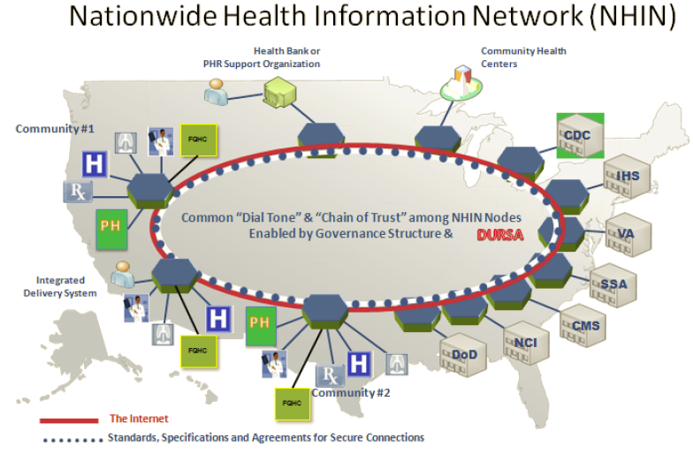
Ultimate Goal:
DHHS NHIN Architecture Overview v.0.9. 2010 April. Available from: www.healthit.hhs.gov
Notes:
Ultimately, the goal (which is not yet realized) would be to have a system in place that facilitates the inter-connectivity of providers in communities and across communities so that patient information can be shared when appropriate.
The exchange of data on such a network would improve the quality of care by making information available in real time – where and when it’s needed – as well as improve efficiencies associated with the duplication of efforts. For example, when a physician doesn’t have a previous test result and as a result has to reorder it, it causes an unnecessary duplication of efforts. HIE would also reduce the problem of inaccessible information which can often result in sub-optimal decision making.
A National Health Information Network, as mentioned, is not yet realized, but there are many efforts at developing strategies for health information exchange. These efforts include a collection of standards, protocols, legal agreements, specifications, and services that enables the secure exchange of health information over the Internet. Whether it is a nationwide network or is, as the Office of the National Coordinator for Health IT call is, an “interoperable health IT infrastructure,’ the vision for nationwide exchange of health information is a major focus of US government health IT strategy.
Such a network would also allow for connectivity to federal agencies that have responsibilities related to healthcare, such as the Centers for Disease Control and Prevention, or the Indian Health Service, or the Veterans Administration. Likewise, the National Cancer Institute or the Department of Defense also have the need to exchange information about patients that they care for. In addition, researchers that deal with patients cared for by these agencies will be able to access important information.

Slide 10
History of HIE
1990: Hartford Foundation funds “Community Health Management Information Systems”
Mid-1990s: Community Health Information Networks (CHINs)
1999, 2001: Institute of Medicine (IOM) Reports on Patient Safety and Quality
Source: (Vest & Gamm, 2010)
Notes:
Now that we have some of the basic concepts out of the way, let’s focus some more on the history of health information exchanges. An excellent article by Vest and Gamm was recently (delete ‘recently) published in the Journal of the American Medical Informatics (pronounced IN-fer-MAT-ics)) Association that nicely covers a lot of the history that I’m going to talk about in the next few slides.
In 1990, the Hartford Foundation gave out several grants to a variety of different cities and locales for the purposes of building what they called, “community health management information systems.” This was one of the first attempts at exchanging information about health electronically.

Slide 11
History of HIE 2
1990: Hartford Foundation funds “Community Health Management Information Systems”
  Grants to seven states and cities to develop these early prototype HIEs
  Focus on quality “assessments” and cost reduction by streamlining patient eligibility information for billing
  Problems: immature technology including slow Internet connections, data integration
Source: (Vest & Gamm, 2010)
Notes:
Seven locations received these grants.
The grantees developed systems that were centralized data repositories that housed patient information including demographics, clinical data, and health insurance eligibility information. The main purpose of the system, according to Vest and Gamm, was for assessment purposes and to make it easier to bill for patient care by having insurance eligibility information verified right away, preventing the need for the onerous paperwork that’s typically generated when denial of payments occurs when patients are treated for something they were not covered for.
None of these systems ultimately survived because, in 1990, technology, including Internet technology, was at a very prototypical stage. This was the first time also that an attempt was made to integrate otherwise disparate health information, which as we have learned over the years is much easier said than done.
Other major problems with the system included privacy concerns. In fact, in some areas where these community health management information systems were created there was a real grassroots effort led mostly by physicians that successfully lobbied the legislature in some states to do away with this health information exchange.
And lastly, because these were grant funded, there was a lot of problems when these systems tried to transition off grant funding support. In other words when the grant money ran out, it became very difficult to continue the operations of these systems because it was not clear exactly who should pay for it and what the return on investment would be for someone who did.

Slide 12
History of HIE 3
Mid-1990s: Community Health Information Networks (CHINs)
  Focus on cost savings associated with moving data between providers
  Decentralized architecture to address privacy concerns
  Most CHINs failed
Source: (Vest & Gamm, 2010)
Notes:
By the mid-1990s another form of HIE came on to the scene; this time in what was referred to as Community Health Information Networks or CHINs (pronounced _chins). Whereas the efforts in 1990 were mostly collaborative endeavors by community stakeholders, CHINs were mainly commercial endeavors. These endeavors were primarily aimed at reducing costs by sharing data.
CHINs tried to overcome some of the pitfalls learned in 1990 that may have led to the demise of the previous attempts at HIE.
For example, given the fierce political opposition by some groups at making community health-level data available publically, CHINs employed decentralized data structures that made them less likely to violate some privacy concerns.
There were approximately 75 to several hundred CHINs established or at least planned, almost all of which failed.
According to Vest and Gamm, there were several major reasons for this failure. First, there was a lack of a focus on community stakeholders, which ultimately left at the table just a bunch of competitors which proved to be a difficult model for success.
In addition, vendors who were building these systems in the hopes of collecting fees seemed to pit the interests of hospitals against those of community physicians, which created some dismay.
And finally, there was no clear return on investment. As you recall, this problem was also experienced with the Community Health Management Information Systems that had that preceded the CHINs.

Slide 13
History of HIE 4
1999, 2001: Institute of Medicine (IOM) Reports on Patient Safety and Quality
Source: (Vest & Gamm, 2010)
Notes:
In 1999, the Institute of Medicine released the first of a series of reports that ignited a national focus on patient safety and quality of care.
The first report, entitled “To Err Is Human,” suggested that as many as 98,000 people die each year as a result of preventable medical errors. A follow-up report in 2001 talked about how Health Information Technologies, including HIE, could be used to reduce errors, and improve the efficiency and effectiveness of our healthcare system.
This new national focus on quality had implications for how the history of HIE continued to unfold.

Slide 14
History of HIE 5
2000: Regional Health Information
Organizations (RHIOs)
  Local “neutral” organizations bringing providers together for HIE
  Focus on quality of care
  “If you’ve seen one RHIO, you’ve seen one RHIO”
Notes:
In the early 2000s a new type of HIE organization began to “pop up.” These organizations, called Regional Health Information Organizations, or RHIOs ( pronounced Rio’s [like Rio Grande]) were local, neutral organizations bringing providers in a community together for the purposes of HIE. RHIOs are usually made up of representatives from a variety of provider organizations in a given area. And consistent with the new national focus on quality (as ignited by the Institute of Medicine reports), RHIOs were mainly focused on improving quality in their communities.
In order to facilitate HIE, RHIOs needed to get everyone at the table to overcome challenges unique to their market. Some of these challenges may have been political, or competitive, perhaps financial or regulatory, and in some cases legal. Note that by this point many of the technical barriers, including immature Internet technologies and the like had been overcome and Internet connectivity and computer hardware had gotten to the point where a lot of things that HIE required technically were much easier to do.
So a RHIO must bring together stakeholders, manage agreements among them, manage security and access to information, and manage identities and log-in credentials, so everyone accessing the local system has access to the data when it’s needed with the correct authentication and security protocols, etcetera. RHIOs differed in how they approached these challenges. In fact, in many ways each RHIO was unique, giving rise to the expression, “If you’ve seen one RHIO, you’ve seen one RHIO.”

Slide 15
History of HIE 6
2004: DHHS begins developing NHIN
2006: AHRQ report: much variability regarding state-level HIE activities
Notes:
RHIOs continue to develop to this day, but it’s important to mention that in 2004 the Department of Health and Human Services began to develop the National Health Information Network, which replaced an earlier concept known as the National Health Information Infrastructure, or NHII (pronounced N-H-I-I). This early phase of the new NHIN (pronounced N-Hin) included developing prototype architectures, and the second phase involved developing specifications and services, and developing working constructs.
In 2006, the Agency for Healthcare Research and Quality, or AHRQ (pronounced ark) released a report that pretty much concluded that a tremendous amount of variability existed from one state to another with respect to RHIO and state level HIE activities. While some states had advanced HIE systems in place, able to exchange data across competing providers, other states had little or no HIE activity. Moreover, state-led activities varied from one state to another as well. Given the many benefits that HIE brings, especially to healthcare payers, such as health insurance companies, state Medicaid programs began leading efforts in their states to develop HIE. Medicaid programs assumed that benefits would accrue to their own budgets if they had a leadership role in convening stakeholders interested in health information exchange.

Slide 16
History of HIE 7
2006: “Leading” RHIO shuts down in Santa Barbara County, CA
Source: (Miller & Miller, 2007)
Notes:
2006 was a milestone year for HIE because a prominent RHIO, which was a pioneer in many ways, failed and closed down eight years after it began its operations.
Some of the reasons it failed were reminiscent of why previous HIE attempts failed. According to Miller and Miller in a 2007 article in Health Affairs, the Santa Barbara RHIO was grant-funded. As a result, while it had strong leadership by the grant foundation and grantees, it also had a consequent lack of major involvement from community stakeholders who were anticipated to move into a more prominent leadership role as the RHIO evolved, and ultimately didn’t.
There were also some problems associated with the fact that a relatively small vendor was trying to develop a product from scratch to handle the HIE needs that were planned for, and this particular vendor wasn’t able to keep up with the demands.
Lastly, the lack of a compelling value proposition, which as we heard previously was the case with earlier attempts at HIE, led to the RHIO’s failure.
One of the most valuable lessons of the failure of this RHIO is the importance of building trust and achieving and constantly updating business agreements among RHIO stakeholders.
The failure of this RHIO also spotlighted the need for health payers to be involved, because the return on investment from HIE is most likely to be achieved for those who pay for healthcare.

Slide 17
History of HIE 8
2009: HITECH Act specifies HIE as a component of “meaningful use” incentives
Notes:
2009 was also another milestone year for HIE with the passage of the Health Information Technology for Economic and Clinical Health Act, or HITECH (pronounced high tech) Act. This legislation marked the broadest federal support for HIE to date. This broad support was on several fronts.
First, the HITECH Act provides incentives for EHR adoption among providers who agree to adopt certified systems and are able to demonstrate that they use these EHR systems in a “meaningful” way. Importantly, one of the criteria for “meaningful” involves the ability to exchange health information with other providers. In other words, in order for doctors and hospitals and other providers to get bonuses from Medicare or Medicaid, their EHRs need to be able to exchange information with other providers.
Second, the HITECH Act also addressed privacy issues by strengthening privacy, security, and confidentiality constructs that were previously outlined in other legislation such as the Health Insurance Portability and Accountability Act, or HIPAA (pronounced HIP-uh). Thus you see more attempts at addressing some of the previous reasons that HIE failed in the past, including concerns about privacy.

Slide 18
History of HIE 9
2010: ONC assures stakeholders that NHIN will not exchange data with government agencies
Notes:
In 2010, as HIE systems were continuing to move forward, concerns about privacy were again raised. With the National Health Information Network being developed, there was concern that since it will be easy for health information to be transmitted, it might be inevitable that certain government agencies would ultimately have access to private information.
Arguments were made that some of these agencies, including the Department of Justice, or the Department of Homeland Security, or the Central Intelligence Agency or CIA should probably not have access to private health information. In an attempt to learn from, or apply the lessons learned from previous HIE historical events, the Office of the National Coordinator for Health IT, or ONC (pronounced O-N-C), assured stakeholders that the NHIN that it was developing (now called the Nationwide Health Information Network) will not exchange information with these government agencies. In addition, implementation of stronger privacy protections as mandated in the HITECH Act has begun.

Slide 19
Recent Efforts in HIE
Types of HIE
  Directed exchange
  Query-based exchange
  Consumer-mediated exchange
ONC vision for an Interoperable Health IT Infrastructure (2015)
Research data exchange: PCORI and NIH
Source: (Office of the National Coordinator, 2015)
Notes:
Within about five years after the passage of the HITECH Act there was great progress in the adoption of EHRs, but much less progress on health information exchange. First of all, many of the challenges described previously still existed. In addition, rather than a national network, there were several different types of architecture for HIE. One type, was provider to provider directed exchange. Another type was query-based, where an entity could query a health information exchange system to find out information about a particular patient. A third type relied on the patient to be responsible for coordinating information.
In 2015 the Office of the National Coordinator published their ideas on what that might look like in a report entitled, “Connecting Health and Care for the Nation: A 10-Year Vision to Achieve an Interoperable Health IT Infrastructure.” In that report, there was a realization that multiple types of HIE (pronounced H-I-E) models may need to be accommodated, but that these models needed to exist in what was called an ‘interoperable health IT ecosystem.’
In addition to the efforts to develop systems for HIE for clinical care, there have also been efforts to exchange clinical data for research on the part of the Patient Centered Outcomes Research Institute and the NIH. It is likely that the advances made on the operational side may facilitate the research efforts and vice versa.
There is still much to do to achieve a fully interconnected system, especially in regard to having agreed-upon interoperability standards, but there is now momentum, incentives, and government support to build this long-overdue infrastructure.

Slide 20
History of Health Information Exchange Summary
HIE efforts are not new in the US
  Each new effort incorporates valuable lessons learned
Current incentives offered in federal legislation give HIE the best shot to date at being realized
Notes:
This concludes History of Health Information Exchange.
In summary, the establishment of HIE has been an elusive, but worthy, goal in the US for several decades. Each concerted attempt at achieving HIE reminds us of the challenges associated with such a lofty goal. The good news is that we have learned a lot about the pitfalls to avoid, and each attempt at achieving true HIE incorporates the lessons learned from the previous attempts.
Currently, political, financial, and social forces are aligning in favor of HIE. Indeed, incentives provided in the HITECH (pronounced High-Tech) Act may be the impetus (pronounced IMP-pet-us) that brings true national HIE to fruition.

Slide 21
History of Health Information Exchange References
References
  Miller RH, Miller BS. The Santa Barbara County Care Data Exchange: what happened? Health Affairs. 2007;26(5):568-80.
  Vest JR, Gamm LD. Health information exchange: persistent challenges and new strategies. JAMIA. 2010;17(3):288-294.
  HealthIT.gov. Health Information Exchange. (HIE). What is Health Information Exchange? Available at: www.healthit.gov. Accessed May 25, 2016.
  Office of the National Coordinator for Health Information Technology. Connecting Health and Care for the Nation: A 10-Year Vision to Achieve an Interoperable Health IT Infrastructure. Available at: www.healthit.gov Accessed may 25, 2016.
Images
  Slide 3: Christian Mehlfuhrer, San Francisco Cable Car CC BY 3.0. Available from: de.wikipedia.org.
  Slide 6: Available from: maps.google.com
  Slide 8: Wall of Files, Alex Gorzen CC BY-SA 2.0. Available from: commons.wikimedia.org.
  Slide 8: Post Office Van, Joseph Barillari CC BY-SA 3.0. Available from: en.wikipedia.org.
  Slide 8: Old Fashioned Telephone, Kornelia und Hartmut Häfele CC BY-SA 3.0. Available from: en.wikipedia.org.
  Slide 8: Fax Machine, Jonnyt, Available from: en.wikipedia.org.
  Slide 9: Available from: healthit.hhs.gov.
Notes:
“No Audio”

Slide 22
History of Health IT in the US
History of Health Information Exchange
This material was developed by the University of Alabama at Birmingham, funded by the Department of Health and Human Services, Office of the National Coordinator for Health Information Technology under Award Number 90WT0007.
Notes:
No Audio.

