Slide 1
Working with Health IT Systems
HIT and Aspects of Patient-Centered Care
Lecture a
This material (Comp 7 Unit 10) was developed by Johns Hopkins University, funded by the Department of Health and Human Services, Office of the National Coordinator for Health Information Technology under Award Number IU24OC000013. This material was updated in 2016 by The University of Texas Health Science Center at Houston under Award Number 90WT0006.
This work is licensed under the Creative Commons Attribution-NonCommercial-ShareAlike 4.0 International License. To view a copy of this license, visit http://creativecommons.org/licenses/by-nc-sa/4.0/.
Notes:
Welcome to Working with Health IT Systems: HIT and Aspects of Patient-Centered Care. This is Lecture a.

Slide 2
HIT and Aspects of Patient-Centered Care Learning Objectives—Lecture a
Define patient-centered care.
Suggest HIT-enabled solutions/strategies to enhance patient involvement in health and healthcare.
Assess the effectiveness of HIT systems in supporting patient-centered care.
Perform self-assessment of personal beliefs related to HIT and patient-centered care.
Notes:
The Objectives for HIT and Aspects of Patient-Centered Care are to:
Define patient-centered care.
Suggest HIT-enabled solutions/strategies to enhance patient involvement in health and healthcare.
Assess the effectiveness of HIT systems in supporting patient-centered care.
Perform self-assessment of personal beliefs related to HIT and patient-centered care.

Slide 3
Patient-Centered Care
What is “Patient Centered Care”?
“providing care that is respectful of and responsive to individual patient preferences, needs, and values” and “ensuring that patient values guide all clinical decisions."
(Crossing the Quality Chasm, 2001)
Notes:
What is patient-centered care and why is this important in our changing healthcare environment? Patient-centered care is defined in the Institute of Medicine’s Crossing the Quality Chasm report as “providing care that is respectful of and responsive to individual patient preferences, needs, and values” and “ensuring that patient values guide all clinical decisions.”

Slide 4
Importance of Patient-Centered Care
Why is it Important?
“When informed patients take an active role in managing their diabetes, and providers are prepared, proactive, and supported with time and resources, their interaction is likely to be productive.” (Better Diabetes Care, 2006)
“patient-centered interaction can lead to better diabetes care, more efficient and effective practices, healthier patients, and more satisfied patients and providers.” (Better Diabetes Care, 2006)
Image Courtesy of the United States Navy
Notes:
According to the National Institutes of Health Better Diabetes Care website focused on patient-centric care, the point is made that “When informed patients take an active role in managing their diabetes, and providers are prepared, proactive, and supported with time and resources, their interaction is likely to be productive.” This site continues to make the assertion that “patient-centered interaction can lead to better diabetes care, more efficient and effective practices, healthier patients, and more satisfied patients and providers.”
Overwhelmingly, the literature is pointing toward better outcomes when patients become partners in their own care.

Slide 5
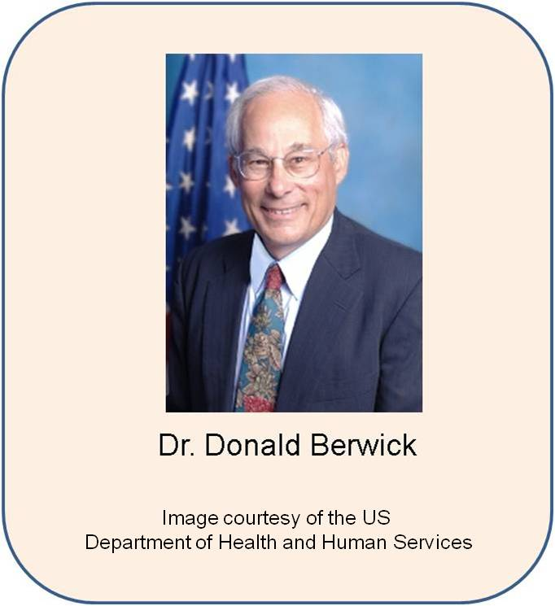
What are the Core Concepts of Patient- and Family-Centered Care?
Dignity and Respect
Information Sharing
Participation
Collaboration
http://www.youtube.com/watch?v=SSauhroFTpk
Notes:
What are the core concepts of patient- and family-centered care? The material on this slide comes from a Public Broadcasting Series (PBS) called “Remaking American Medicine,” a four-part television series that follows pioneering individuals working to change our healthcare system for the better in the United States.
The four core notions of patient-and family-centered care that are presented in this series echo the concepts that we just discussed.
The first concept is dignity and respect. Patient-centered care responds to the patient’s needs, wants, and preferences, and takes into account the cultural and traditional aspects that are important to the patient and his family. It calls for treatment of the patient as an individual, which requires customization of the plan of care and encourages the patient to learn more about his condition so that he is better prepared to take an active role in medical decision making.
Information sharing, the second aspect of patient-centered care, speaks directly to the way in which we help to create and foster the development of the informed and knowledgeable patient and family. Patients and their caregivers want to know what the condition is that they have, what the prognosis is, what it means for them and their family, how they are going to live with their disease, and what are the consequences of failure to take care of themselves. They want to understand what the treatment is, how much it is going to cost, and what the side effects are. Of course all of this needs to be in a language they understand. They need answers that are accurate and able to be understood. This brings to mind some of the work of the National Library of Medicine and its attention to the “information prescription,” where patients are actually “prescribed” an intervention that requires that they access information that makes them smarter patients and smarter consumers of healthcare services. This is where the open access to knowledge, which was once restricted to physicians, their charts, or locked up in a medical library somewhere, can really be used to support patient-centered care. “Knowing” is one of the most powerful tools that a patient and his family has because it contributes to better outcomes and more efficient care.
The third concept, participation, goes hand in hand with the prior two concepts. In the series, “Remaking American Medicine,” it is pointed out that patients and family must be “encouraged and supported in participating in care and decision-making at the level they choose.”
Collaboration is the final concept. It is interesting that this concept includes shared decision-making at the policy and planning level as well as at the direct intersection of the patient and the healthcare system. This aspect encourages the involvement of the patient, the family, and the caregivers in helping to plan not only the plans of care that will help a patient to achieve an optimal level of health, but also in the development of policies and physical aspects that help the patient to succeed. Including the patient and/or family perspective in the way that care is provided or in the way that a unit is designed are examples.
For instance, not too long ago, the idea of a parent rooming in with a sick child was absolutely unheard of. It would be terrifying for a child when her mother would go home at night. Fortunately, all that has changed. In one case, a pediatric unit was designed based on recommendations by focus groups made up of patients and their parents (these were primarily those with chronic illnesses who spent considerable amounts of time in the hospital). The uncomfortable lounge chairs that exhausted parents were expected to rest in were eliminated. They were replaced with fold-out chairs that go completely flat and make a reasonably comfortable bed. Children were asked about what they wished to eat so that children could actually have some say in (within limitations of course) what they would like to have on a meal tray or at snack time. The point here is that the collaboration is vital to the achievement of true patient-centered care.
Pictured here is Dr. Don Berwick, who is the former Administrator of the Centers for Medicare and Medicaid (also known as CMS). You can view a compelling video of Dr. Berwick discussing what Patient-Centered Care means to him. The YouTube address is listed on the slide and is closed captioned.

Slide 6
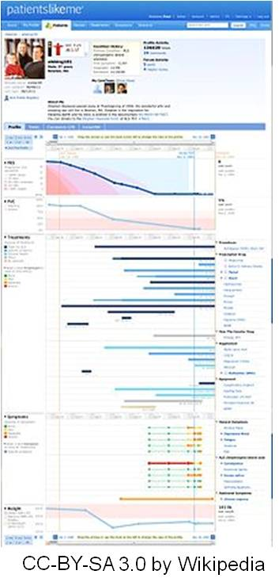
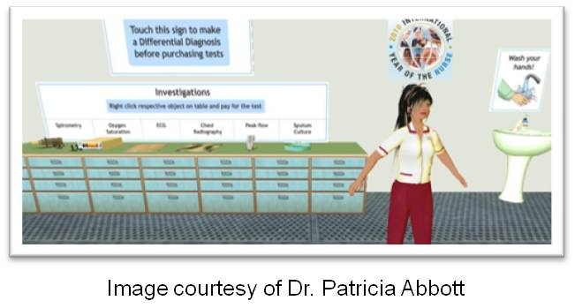
Rise of the Active Patient
“Americans' pursuit of health takes place within a widening network of both online and offline sources. Whereas someone may have in the past called a health professional, their Mom, or a good friend, they now are also reading blogs, listening to podcasts, updating their social network profile, and posting comments.” (Fox & Jones, 2009)
Notes:
The Pew Internet Study of 2009 is an illustration of some of the impetus of patient-centered care. There is a driving force that the study refers to as the “rise of the active patient” that is contributing to the call for patient-centeredness. The American public, once content with static pages of health information, is shifting toward active information provision. The public is moving toward reading blogs and participating on social networks and the like. Patients are changing, our healthcare system is changing—along with this the provider population and the educational system that trains them must change as well. It is a new world.
One of the incredibly popular social networking sites at present is called “Patients Like Me,” where people with similar health concerns interact with one another, learn from one another, and become
more empowered patients. You may want to visit this site if you have not seen it already. If you have not experienced virtual worlds such as SecondLife, you should become acquainted with it. There is tremendous growth in that sector as well in regards to both the active patient and virtual simulation and interaction for education of health professionals.
The point here is that patient-centered care is not a movement that some genius in an office came up with. It is a natural byproduct of information access that has been enabled by the growth of information and communication technologies.

Slide 7
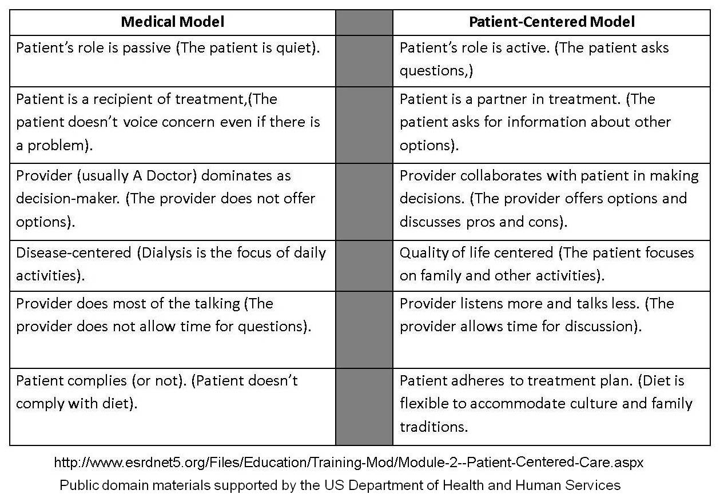
Medical Model VERSUS Patient-Centered Model
Notes:
It may be helpful to you to have a side-by-side comparison of how the old way of doing things compares to the new way of doing things regarding patient-centricity. The model on the right (which is the patient-centered model) is the direction the US Healthcare industry is moving in. This image was taken from the End Stage Renal Disease website, which is in the public domain, and was funded by the Center for Medicaid and Medicare Services.
As we examine this grid—moving from left to right—we see in the first cell that the goal is to move from the passive patient who is quiet and just listens, to a more active role where the patient asks the questions. You can see in the second box of the medical model that the patronistic method of the patient simply accepting the plan of care is moving toward the patient as an active partner in planning for his care. These patients voice their concerns, inquire about different options, and let the provider know if there is a problem with what is being planned. This relates also to the next to the last box on the left-hand side where the provider does most of the talking—we are shifting to letting the patient ask questions and the provider takes the time to answer. Now in reality, we also know that providers cannot spend huge amounts of time with each patient, so there is a bit of a tension here between what we SHOULD do and what we CAN do in the real world.
We are also seeing a shift from the provider being the sole decision maker. In patient-centered care, the decision is in the hands of the patient and his family. The role of the provider becomes one of providing options with the pros and the cons—and helping the patient and his family to arrive at a decision that works best for all of them.
We are also moving away from a disease-centered model where we manage illness instead of managing health. The patient-centered model focuses more on quality of life issues and helping patients to achieve and then maintain an optimal level of health.
The final box shows that in the old Medical Model that the patient is either compliant—or not. In a patient-centered world, the goal is to work with the patient to develop a treatment plan that is realistic and takes into consideration the situation, the patient’s culture and family traditions, or as reflected in the definition of patient-centered care, the plan takes into the account the patient’s preferences, his needs, and his values.
We challenge you to think about the goals of the patient-centered model and to think about how Health IT can support these goals. The assignment associated with this unit will have you recall this grid and think about the relationship between patient-centered care and Health IT-enablement. In addition, in the assessment you will be asked to share your own perceptions and your own personal beliefs related to Health IT and patient-centered care.

Slide 8
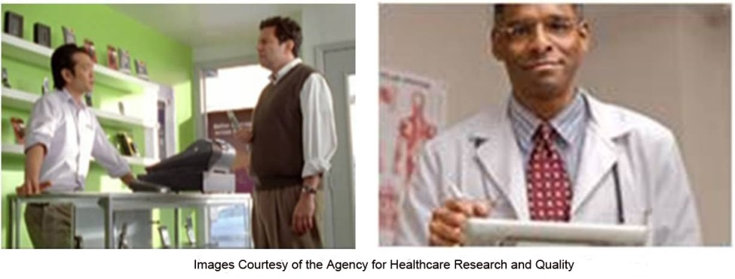
A Public Service Announcement from AHRQ.Gov
Questions Are the Answer Medical errors cause tens of thousands of deaths each year. But you can help. Get more involved with your health care. http://www.ahrq.gov/patients-consumers/patient-involvement/ask-your-doctor/index.html
Notes:
To further emphasize these points, the Agency for Healthcare Research & Quality (also known as AHRQ) created these public service announcements with the Ad Campaign to encourage patients to ask questions and to take a more active role in their care. This creative and entertaining series of announcements are crafted to convince people that questioning your provider should not be looked at like you are challenging what he says. Instead it’s about encouraging proactivity.
Now this action, in and of itself, is another one of those cultural or behavioral changes that is very difficult. For instance, many older patients would never dream of questioning their doctor. Certain cultures, where the doctor is revered, would also find it difficult to ask a question. The issues of language enter into the equation as well, for example, patients whose primary language is not English, and those who do not speak the language at all, would have a very difficult time communicating in this manner. Some providers would prefer that patients DON’T ask them a question in the first place, believing it’s just easier and better for the patient to do as they are told, and fewer questions means the quicker they can get to the next patient.
It really takes a culture change all the way around and that’s what the movement toward patient-centered care is advocating.
The AHRQ.gov site has several short videos that are closed-captioned and do a terrific job of trying to break down the uncomfortable feelings that often accompany questioning a provider. Please take a moment to watch these videos if you have a connection to the Internet. They can be found on the AHRQ.gov site or by using any search engine with the terms “AHRQ Questions Are the Answers.”

Slide 9
Measuring Effectiveness of Patient-Centered Approaches
Patient-Centered Care Through Health IT. October 2014. Agency for Healthcare Research and Quality, Rockville, MD.
http://www.ahrq.gov/research/findings/evidence-based-reports/er206-abstract.html
Notes:
The final objective to be covered in this lecture involves the assessment of the effectiveness of HIT systems in supporting patient-centered care. A comprehensive study from the Agency for Health Care Research and Quality was released in 2012. This report was commissioned by AHRQ to analyze the impact of HIT on patient-centered care.
This report, “Enabling Patient-Centered Care through Health Information Technology,” focuses on the development of a comprehensive understanding of the impact of health information technology applications developed and implemented to enhance the provision of patient-centered care. Evidence-based comprehensive analysis of the impact of Health IT on quality of patient- centered care was undertaken as a part of this report. In addition, barriers and facilitators of health IT-enabled patient-centered care were reviewed systematically.
In this report, you can find specific data that relates directly to this objective.

Slide 10
HIT and Aspects of Patient-Centered Care Summary – Lecture a
There is not one "best" computer
Depends on users’ needs
ApplicationsBetter outcomes with engaged patients
Patient values guide all clinical decisions
Four core concepts of patient and family centered care
Dignity and Respect; Information Sharing; Participation; Collaboration
Patient Centered Care - how is it different from Medical Model?
The engaged patient
Storage
Mobility
Budget
Can change quickly due to frequent improvements in technology and price
Notes:
This concludes Lecture a of HIT and Aspects of Patient-Centered Care. In summary, in this unit we focused on the concepts of patient-centered care, its definition, why it is important, and how our healthcare environment is shifting to place the patient and his family back at the center of care decisions. What role does health IT play in the achievement of patient-centered care? We know from the literature that the chance of better outcomes is increased when the patient becomes a partner in his own care. These outcomes may not just be related to health outcomes—patient satisfaction, improved quality of life, and patient empowerment are other outcomes that can improve when patient involvement in his care increases. Ultimately, patient values should guide all clinical decisions. Using IT to engage the patient, to educate the patient, to share and collaborate with the patient is a method that we can use to achieve patient-centered care.
Dignity and respect, information sharing, participation, and collaboration—the four core concepts of patient- and family-centered care are vital aspects. Ultimately, creating and fostering the development of the informed and knowledgeable patient and family while respecting their culture and preferences is imperative if we ever hope to “put the patient at the center.” An engaged patient is one who expects and benefits from participation and sharing. It has been said that the new mantra in healthcare should be “no decisions about me without me.”
We discussed the difference between the dated medical model of patronizing healthcare and a more patient-centered focus. No longer can we dictate treatments or plan care FOR a patient. We will coach patients, plan WITH patients and families, and move toward promoting health instead of managing illness. Health IT can help us with this quest—as telecommunications and connectivity ripple outwards, we now have additional tools to support enhanced communication and engagements with patients and their families.
Kairos, a figure from Greek Mythology, is called the god of the opportune moment. When we combine the movement toward patient-centered care with the growing expansion of telecommunications and internet—Kairos comes to mind. It is an opportune moment to combine health IT, the engaged patient, and the shift to patient-centered care to improve what we do, how we are doing it, and how we interact with our patients and communities.
The final objective to be covered involves the assessment of the effectiveness of HIT systems in supporting patient-centered care.

Slide 11
HIT and Aspects of Patient-Centered Care References – Lecture a
References
Better Diabetes Care. Courtesy: National Institutes of Health. .Available from: http://betterdiabetescare.nih.gov/WHATpatientcenteredcare.htm
Christopher, F., Eisen, M., (2006). Remaking American Medicine [Documentary film]. USA: Crosskeys Media.
Crossing the Quality Chasm: A New Health System for the 21st Century: Committee on Quality of Health Care in America; Institute of Medicine, Washington, DC, 2001.
Downs, S. (2010). Why I Want a Blue Button. Huffington Post. Available from: http://www.huffingtonpost.com/stephen-j-downs/why-i-want-a-blue-button_b_768195.html
Enabling Patient-Centered Care through Health Information Technology (Health IT). Available at: http://www.ahrq.gov/clinic/tp/pcchittp.htm
Fox, S., Jones, S. The Social Life of Health Information. Pew Internet. 2009. Available from: http://www.pewinternet.org/Reports/2009/8-The-Social-Life-of-Health-Information.aspx
Video: Don Berwick—What Patient Centered Care Really Means. Available from: http://www.youtube.com/watch?v=SSauhroFTpk
Notes:
No Audio. Ten seconds of silence.

Slide 12
HIT and Aspects of Patient-Centered Care References – Lecture a (cont’d)
Images
Slide 1: Hispanic Man & Nurse Practitioner. Available from: http://www.flickr.com/photos/usdagov/5059815989/sizes/m/in/photostream/
Courtesy the US Department of Agriculture: Attribution-NoDerivs 2.0 Generic (CC BY-ND 2.0) USDA
Slide 3: Image 1—Elderly Gentleman. Courtesy the National Institutes of Health. Available from: http://betterdiabetescare.nih.gov/MAINframework.htm
Image 2—Girl, Provider, and Mother. Courtesy the National Institutes of Health. Available from: http://betterdiabetescare.nih.gov/MAINwhat.htm
Slide 4: Diabetes Education nurse. Courtesy United States Navy Photos: Available from: http://tinyurl.com/z5vsn4m
Slide 5: Don Berwick. Courtesy US Department of Health and Human Services. Available from: https://en.wikipedia.org/wiki/Donald_Berwick#/media/File:Donald_Berwick_CMS_Administrator.jpg
Slide 6: Image 1—Nursing Avatar. Courtesy Dr. Patricia Abbott.
Image 2—Patient Like Me. Available from: http://en.wikipedia.org/wiki/Patients_like_me.
Slide 7: A Medical Model VERSUS Patient-Centered . Adapted from public domain materials supported by Department of Health and Human Services. Available from:
http://www.esrdnet5.org/Files/Education/Training-Mod/Module-2--Patient-Centered-Care.aspx
Slide 8: Man Questioning Another and African American Clinician with Clipboard:. Agency for Healthcare Quality and Research: Available from: http://www.ahrq.gov/questionsaretheanswer/
Slide 9: Screenshot of http://www.ahrq.gov/clinic/tp/pcchittp.htm. Courtesy Dr. Patricia Abbott.
Slide 10: A Picture of the Greek God Kairos.-Available from: http://www.museoegizio.it/
Notes:
No Audio. Ten seconds of silence.

Slide 13
Working with Health IT Systems HIT and Aspects of Patient-Centered Care Lecture a
This material was developed by Johns Hopkins University, funded by the Department of Health and Human Services, Office of the National Coordinator for Health Information Technology under Award Number IU24OC00013. This material was updated by The University of Texas Health Science Center at Houston under Award Number 90WT0006.
Notes:
No Audio.

