Slide 1
Working with Health IT Systems
HIT and Aspects of Patient- Centered Care
Lecture b
This material (Comp 7 Unit 10) was developed by Johns Hopkins University, funded by the Department of Health and Human Services, Office of the National Coordinator for Health Information Technology under Award Number IU24OC000013. This material was updated in 2016 by The University of Texas Health Science Center at Houston under Award Number 90WT0006.
This work is licensed under the Creative Commons Attribution-NonCommercial-ShareAlike 4.0 International License. To view a copy of this license, visit http://creativecommons.org/licenses/by-nc-sa/4.0/.
Notes:
Welcome to Working with Health IT Systems: HIT and Aspects of Patient-Centered Care. This is Lecture b.

Slide 2
HIT and Aspects of Patient-Centered Care Learning Objectives—Lecture b
Define patient-centered care.
Suggest HIT-enabled solutions/strategies to enhance patient involvement in health and healthcare.
Assess the effectiveness of HIT systems in supporting patient-centered care.
Perform self-assessment of personal beliefs related to HIT and patient-centered care.
Notes:
The Objectives for HIT and Aspects of Patient-Centered Care are to:
Define patient-centered care.
Suggest HIT-enabled solutions/strategies to enhance patient involvement in health and healthcare.
Assess the effectiveness of HIT systems in supporting patient-centered care.
Perform self-assessment of personal beliefs related to HIT and patient-centered care.

Slide 3
Measuring Effectiveness of Patient-Centered Approaches
Potential Variables to Measure:
The communication, respect, trust and caring experienced with providers
Degree to which patients have their unique needs and values considered during diagnosis & treatment
Perception of understanding options and being involved in making medical decisions
Patient’s ability to get the information, education and support needed to care, prevent, & manage health
Receiving support and follow-up when sick or need to manage a complex health condition
Notes:
There is a paucity of data related to how effective Health IT is in supporting patient-centered care. There are some studies that suggest a strong impact, and anecdotal evidence abounds. However, a solid knowledge base in this area is lacking, hence the effort of AHRQ to commission an evidence-based comprehensive analysis of the impact of HIT on patient-centered care.
Does this mean that there is no way to actually measure patient-centered care at present? No. In reality, patient-centered care is not a new concept—what is new is the study of how Health IT can affect patient-centered care. In general, much of the prior measurement of patient-centered care has focused on several variables.
One variable is the measurement of the communication, respect, trust, and caring that patients experience with their providers. This includes the degree to which patients perceive that they are having their unique circumstances and their values considered in the diagnosis and treatment of their (or their loved one’s) illness. Understanding the options that are presented to patients is important so they feel that they are involved in making medical decisions.
Another aspect that is measured is the patient’s perceived ability to get the information, education, and support he needs to care for himself or his loved ones.
The final variable to discuss that is frequently measured is the degree to which the patient, or the caregiver, feels he receives support or follow up when he is sick, or when he needs to manage a complex health condition.
There are aspects of each of these variables that are inherently linked with Health IT—information access and shared decision-making. For instance, it could be that enabling a patient to email with his provider would impact one variable, or that a patient-oriented decision-support system could help the patient to consider the options available for treatment of a particular condition. Imagine a kiosk in a waiting room that could help patients to consider the options available for treatment of a particular condition. How about a kiosk in a waiting room that assists a pregnant woman in making a decision to either breast or bottle feed, to have a tubal ligation during a scheduled Caesarian section or not, to choose whether to circumcise a male child or not? A simple system could provide information with
the presentation of pros and cons of each approach, which enables the patient to make an educated decision (or to assemble further “questions to ask”) when meeting with the provider.
That report available from AHRQ mentioned in Part 1 makes these linkages clearer and further describes how and if Health IT impacts upon patient-centered care.

Slide 4
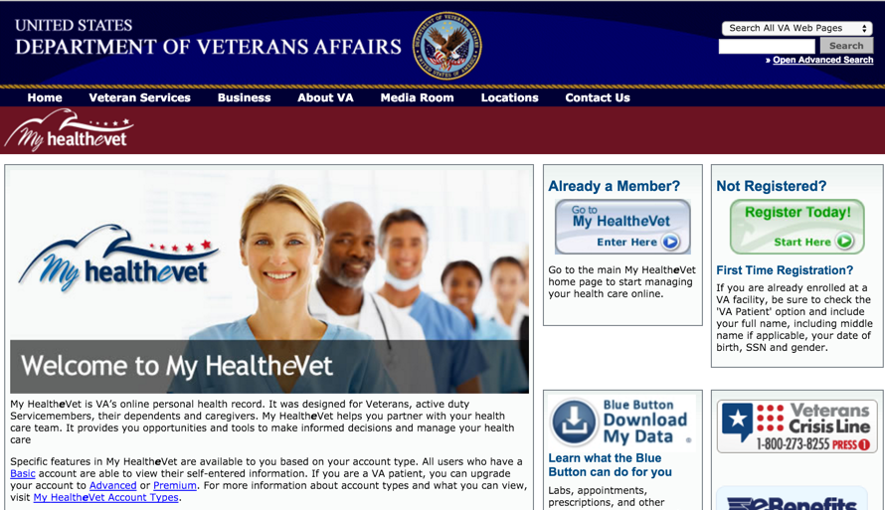
Exploring an Example of HIT Supported Patient Centered Care
https://www.myhealth.va.gov/index.html
Image courtesy of the US Department of Veterans Affairs
Notes:
The final attention that we are going to pay to this concept of patient-centered care supported by HIT will be to let you experience, up close and personal an example of patient-centered care supported by Health IT that the Department of Veterans Affairs (VA) uses. It’s called My HealtheVet and it is a web portal designed by the VA to engage their patient population in health promotion and disease prevention. Keep in mind that this is not an example of perfection. It is, however, open and free to use, and will give you, as a student, the idea of what the marriage of Health IT and patient-centered care can include.
We want to acknowledge the gracious assistance of Dr. Kathleen Charters, from the VA, a colleague who helped with the development of this unit, and the Virtual E-Health University (VeHU) in providing material for this unit in regards to the My HealtheVet slides and narrative.

Slide 5
My HealtheVet
My HealtheVet is a web-based application designed for veterans, their families, & their friends with the goal of optimizing veterans’ healthcare
Holistic - Supporting body, mind, & spirit
VA benefits, programs, & services
Personal Health Record
Self-entered personal & health-related information (patient participation)
Extracts from the VA electronic medical record
http://www.myhealth.va.gov/
Notes:
What is My HealtheVet?
According to the My HealtheVet website, “My HealtheVet is intended to improve the delivery of health care services to veterans, to promote health and wellness, and to engage veterans as more active participants in their health care.”
According to the CMS Site for the VA Blue Button,
“The My HealtheVet portal enables veterans to create and maintain a web-based personal health record (PHR) that provides access to patient health education information and resources, a comprehensive personal health journal, and electronic services such as online VA prescription refilling and secure messaging. Copies of key portions of the VA Electronic Health Record system are added to the PHR incrementally. Veterans can visit the My HealtheVet website and self-register to create an account, although registration is not required to view the professionally sponsored health education resources, including topics of special interest to the veteran population. But once registered, veterans can create a customized PHR that is accessible from any computer with Internet access. For veterans who are VA patients, a one-time identity verification process called In Person Authentication or IPA, at a local VA facility provides access to additional features, such as the ability to import extracted VA EHR or the CPRS data to create a complete summary of both VA medications and patient’s self-entered prescriptions, over the counter medications, herbals, and supplements. The site also includes a customizable health calendar, online learning modules, and self-assessment modules.”

Slide 6
My HealtheVet “Blue Button”
VA's Blue Button:
allows patients to download all their information in their My HealtheVet account
patients are able to create a comprehensive report of all the data contained in their My HealtheVet account
patients can view, print, or store their data
One goal of Blue Button is to help patients better manage their overall healthcare by being able to share health information with those they trust. It puts patients in control.
“Blue Button, the slogan, ‘Download My Data,’ the Blue Button Logo, and the Blue Button Combined Logo are registered service marks owned by the U.S. Department of Health and Human Services.”
Notes:
The Blue Button effort actually helps the veterans download and save their information from their My HealtheVet account on individual computers and portable storage devices. With the advent of the Blue Button feature, CMS is following suit. Now, similar to the Blue Button, Medicare beneficiaries are also able to view their claims and self-entered information—and they are able to export that data into their own computer.
The whole goal here is to help patients better manage their overall health by allowing them to both share their health information with those they trust and be in control of their own personal health data. Prior to the Blue Button, patients could only view their data—but that has all changed now.

Slide 7
“Why I Want a Blue Button”
“As many have experienced, getting a copy of your medical records is rarely as simple as it sounds. The process often involves making multiple phone calls, having to fax in requests, paying photocopying charges and waiting - often as much as a few weeks. And at the end of the process all you have is a stack of paper—good for reading and for filing away, but not much else. But today, as more and more hospitals, pharmacies, and physician offices are adopting electronic medical records, the process should get better. Health care institutions in the vanguard of information technology and customer service are making it possible for their patients to review their records online. But not necessarily take them with them.” (Downs, S., 2010)
Notes:
This quote comes from an article in the Huffington Post, “Why I want a Blue Button,” by Stephen Downs. He says, “… getting a copy of your medical records is rarely as simple as it sounds. The process often involves making multiple phone calls, having to fax in requests, paying photocopying charges and waiting often as much as a few weeks. And at the end of the process all you have is a stack of paper—good for reading and for filing away, but not much else. But today, as more and more hospitals, pharmacies, and physician offices are adopting electronic medical records, the process should get better. Health care institutions in the vanguard of information technology and customer service are making it possible for their patients to review their records online. But not necessarily take them with them.”
And that is the benefit of the blue button.

Slide 8
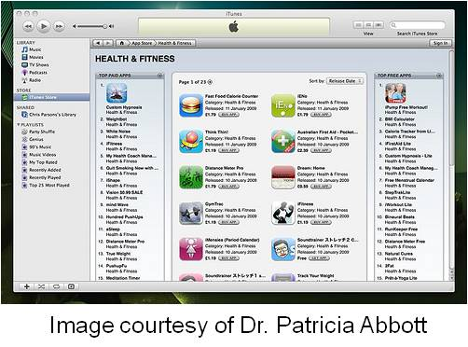
“Why Does It Matter?”
Better engagement in health
Learn more about conditions
Springboard to provider conversations
Can’t we do that with paper already?
Yes, but the difference is
in the sharing & the apps!
Notes:
Steven Downs continues on this topic.
“Why does it matter? For starters, reviewing medical records is a step towards better engagement in personal health. Patients can learn more about their condition, their lab results and the treatments they might be undergoing. They can use the records as a springboard to conversations with their provider.”
“It can be said that we can already do that with paper records, right? Why does digital matter? Well two reasons: sharing and apps. Of course, when a patient gets their paper records, they can be photocopied and sent on to someone to review them. We all know that it's much easier and faster if we can just share digital information online. Being able to quickly forward lab results or a medical history to a consulting provider suddenly becomes quite easy.”
“But the real power lies in the apps. So we live in a world where there really is an app for just about everything. There are 6,000 apps for the iPhone that focus on health and wellness and fitness. They help with day-to-day health-related tasks, like managing your diet, tracking your exercise, understanding your meds, or checking out your symptoms. But these apps are, by and large, ignorant of the details of your health that could make them smarter and offer you more value. Many of them, and many that will soon be invented, could be better if they could draw upon the information contained in your medical records—to spot trends in your lab values and warn you when a trend is of concern; to correlate your moodiness with a new drug or medication you're taking; or to remind you it's time to order that prescription refill, just to name a few.”

Slide 9
Experiencing My Healthe Vet
Access the Website at: https://www.myhealth.va.gov
Take the tour:
https://www.myhealth.va.gov/mhv-portal-web/ShowDoc/BEA%20Repository/multimedia/mhv_tour/VirtualTour.swf
Complete the student activity as directed by instructor.
Notes:
So, rather than just talk about it and show you a bunch of slides, our goal is to “have thy hands touch the keyboard.” For this part of the unit (the laboratory experience) we will require that you access the My HealtheVet web portal, complete a short orientation video, and then complete the student activity that will be provided by your instructor.
To take the tour or watch the video, use the URL on the slide. Once you are done with the video tour, log in to the My HealtheVet web portal to complete the assignment.
Because you are a guest in the My HealtheVet site and this is a federal site, just as with the VistA CPRS demo system, you are expected to conduct yourself and all of your activities in a professional manner and refrain from non-professional or questionable behavior and actions.
The purpose of this exercise is simply to give you hands on experience and a firsthand look at what is possible, where improvements can and should be made, and to stimulate you to think about the future in regards to patient-centered care supported by Health IT

Slide 10
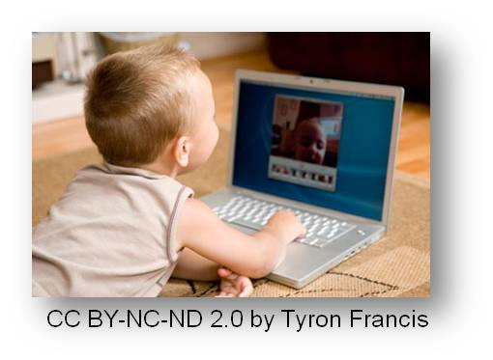
HIT and Aspects of Patient-Centered Care Summary—Lecture b
Define patient-centered care.
Suggest HIT-enabled solutions/strategies to enhance patient involvement in health and healthcare.
Assess the effectiveness of HIT systems in supporting patient-centered care.
Perform self-assessment of personal beliefs related to HIT and patient-centered care.
Notes:
This concludes HIT and Aspects of Patient-Centered Care. In summary, we have covered patient-centered care and discussed some strategies in which Health IT can be used with patients to increase their engagement. Assessing the efficiency of Health IT systems in supporting patient-centered care will be clearer once the AHRQ report is released later, but in the interim, variables that are often collected and can be thought of in relation to Health IT were covered. Finally, in the assessment exercise, you will have the opportunity to express your beliefs and offer suggestions for improvement of the current processes of patient-centered care using Health IT.
Pictured at the bottom here is a generation of informatics natives that are waiting in the wings—who will continue to drive change and new ways of thinking and doing. They have grown up in a world of open information access. We can only hope that the availability of health information and a major shift toward “patient as partner” makes for a more informed healthcare services consumer and results in better health for all.

Slide 11
HIT and Aspects of Patient-Centered Care References—Lecture b
References
Blue Button Initiative. CMS. Available from: https://www.cms.gov/NonIdentifiableDataFiles/12_BlueButtonInitiative.asp
Downs S. (2010). Why I Want a Blue Button. Huffington Post. Available from: http://www.huffingtonpost.com/stephen-j-downs/why-i-want-a-blue-button_b_768195.html
Images
Slide 4: My HealthyeVet site. Courtesy the US Department of Veterans Affairs. Available from:
www.myhealth.va.gov
Slide 5: My HealthyeVet Banner . Courtesy the US Department of Veterans Affairs . Available from: www.myhealth.va.gov
Slide 6: Blue Button. Courtesy of the US Department of Veterans Affairs. Available from: www.myhealth.va.gov
Slide 8: I-pad health apps. Courtesy Dr. Patricia Abbott
Slide 10: Baby on computer .Source: http://www.flickr.com/photos/tfrancis/539308690/sizes/m/in/photostream/ Tyron Francis. Attribution-NonCommercial-NoDerivs 2.0 Generic (CC BY-NC-ND 2.0)
Notes:
No Audio. Ten seconds of silence.

Slide 12
Working with Health IT Systems HIT Facilitated Error— Cause and Effect Lecture a
This material was developed by Johns Hopkins University, funded by the Department of Health and Human Services, Office of the National Coordinator for Health Information Technology under Award Number IU24OC00013. This material was updated in 2016 by The University of Texas Health Science Center at Houston under Award Number 90WT0006.
Notes:
No Audio.

