Slide 1
Working with Health IT Systems
Health IT in the Future
This material (Comp 7 Unit 11) was developed by Johns Hopkins University, funded by the Department of Health and Human Services, Office of the National Coordinator for Health Information Technology under Award Number IU24OC000013. This material was updated in 2016 by The University of Texas Health Science Center at Houston under Award Number 90WT0006.
This work is licensed under the Creative Commons Attribution-NonCommercial-ShareAlike 4.0 International License. To view a copy of this license, visit http://creativecommons.org/licenses/by-nc-sa/4.0/.
Notes:
Welcome to Component 7, Working with Health IT Systems, Unit 11, Health IT in the Future.

Slide 2
Health IT in the Future Learning Objectives
Speculate on the relationship between HIT and health reform.
Suggest alternative designs for usable & supportive HIT.
Hypothesize how HIT may intersect with publicly available data to improve health (i.e. Point of Sale, weather, GIS, foods, etc.).
Predict avenues of future innovations in HIT.
Notes:
The Objectives for Health IT in the Future are:
Speculate on the relationship between HIT and health reform.
Suggest alternative designs for usable & supportive HIT.
Hypothesize how HIT may intersect with publicly available data to improve health (that is Point of Sale, Weather, GIS, foods, etc.). And.
Predict avenues of future innovations in HIT.

Slide 3
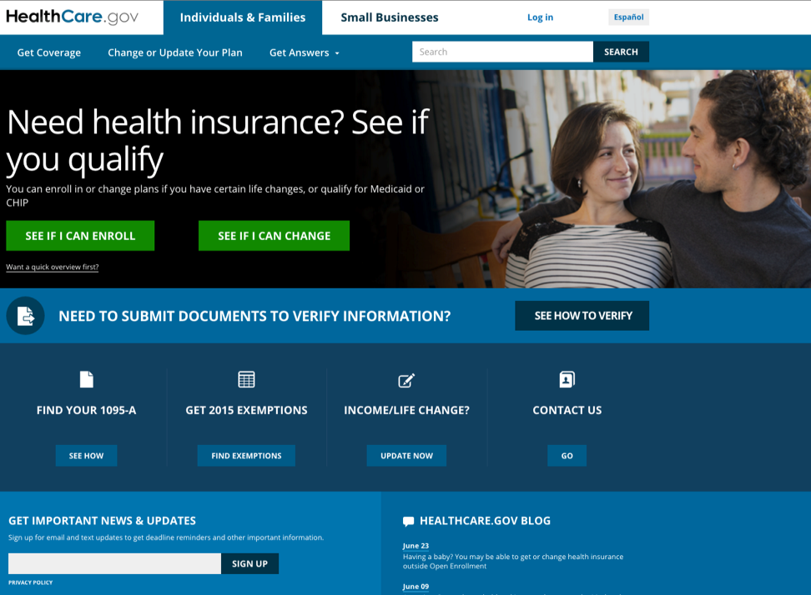
Reform of the US Healthcare System
Patient Protection &
Affordable Care Act of 2010
CMS Center For Innovations
“Journeys of care, not
fragments of care” (Berwick)
http://www.healthcare.gov
(HealthCare.gov, 2016)
Notes:
Many would probably agree that our healthcare system is in trouble and must be fixed. The Centers for Medicare and Medicaid Services, Office of the Actuary states, “Health care costs have been rising for several years. Expenditures in the United States on health care surpassed $2.3 trillion in 2008, more than three times the $714 billion spent in 1990, and over eight times the $253 billion spent in 1980. Stemming this growth has become a major policy priority, as the government, employers, and consumers increasingly struggle to keep up with health care costs.” The continual struggle to keep up with the cost of health care services is unsustainable, particularly in light of a global recession.
To add insult to injury—even though we, as a nation, spent these huge sums of money on healthcare, the US is still a poor performer when compared to other developed nations around the globe. The Commonwealth Fund ranked the United States last in the quality of healthcare among similar countries and notes that US health care costs are far above other developed nations. According to Roehr, in a June 2008 article from the British Medical Journal, "Health care in US ranks lowest among developed countries." How can this be? How did we get to this point and how can we reverse the trend?
Movements are underway to try to address the issues that plague the US healthcare system. Of particular note is the Patient Protection and Affordable Care Act of 2010—(also called the Accountable Care Act or ACA), which was signed into law early 2010. The ACA has catalyzed efforts to radically transform the current way that care is provided and reimbursed.
Think about how Health IT can help us to win this war. What have you learned so far about the capabilities of Health IT that can help us to provide higher quality and more effective health and healthcare services? How might the ACA help us to achieve these lofty goals?
One ACA aspect that calls upon health IT is the “Center for Innovations” at the Center for Medicare and Medicaid Services, or CMS. This Center has a 10 billion dollar budget to identify and test promising new models for delivering and paying for healthcare. Dr. Don Berwick, the current director of CMS, says that patients need “journeys of care, not fragments of care,” so one of the ambitions of this “test-bed” is to figure out what it would take to remove the fragmentation and make the journey smooth and safe for all of us. It does not take a rocket scientist to figure out that we cannot reduce fragmentation and smooth care journeys without a way to facilitate information exchange.

Slide 4
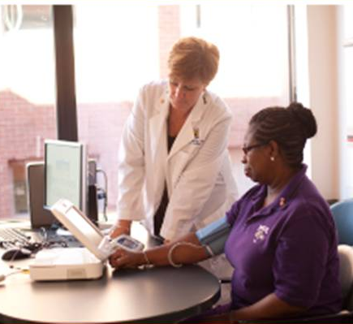
Reform & HIT
Fragments and fractures
ACA – AHRQ Center for QI and Patient Safety
Telehealth expansion
Image Courtesy of Dr. Patricia Abbot.
Notes:
Have you personally been on a healthcare journey where everything is smooth and worry-free? If so, congratulations—and you may be one of a select few who can say that. Conversely, how many times have you—as a parent, as a child, or in your own personal life—had to run around gathering health data on your own? How many “uh-ohs” have you said—or heard in relation to a healthcare experience? How many “near misses” or “almost errors” have you witnessed in healthcare?
Fragments and fractures pervade our healthcare system. These troubles are ones Dr. Patricia Abbott experienced firsthand when her father struggled with an illness, she said.
”Before my father passed away, he was seeing four different doctors and none of them knew what the other was doing, ordering, or planning. At the time of my father’s death from an undetected drug toxicity induced respiratory failure, he had spent four weeks in two different medical intensive care units, developed ventilator acquired pneumonia and three pressure ulcers, contracted a central line blood stream infection, and had a fall in the hospital.
On his admission to the last medical intensive care unit, the chief resident took me aside, presented me with a collection of paper records jammed in a chart—that was at least 12-inches thick, and said ‘Can you just tell me what this all says? I will spend hours trying to figure out your dad’s story trying to wander through all of this.’
For the privilege of this disjointed and heart breaking adventure, Medicare and Medicaid got to pay close to one half of a million US dollars. My beloved father—a victim of fragments and failures, never made it out of the hospital. It has been two years now and I still am haunted by the system failures and that 12-inch stack of jumbled paper medical records. We can do better – we must do better.”
One of the major direction-changing goals of the ACA-driven Center for Innovations is to figure out how to test—and then take—new models of care into practice. It requires investigation of how to unlock and exchange precious yet siloed data, and remove the fragmentation and disconnections that are the hallmarks of healthcare in the US.
The Accountable Care Act, Section 3501 (Part 933) also calls for the Agency for Healthcare Research and Quality, (AHRQ) Center for Quality Improvement and Patient Safety to “Identify, develop, disseminate and provide training in health care quality, safety, and value” and to “provide for the funding of these activities of organizations with recognized expertise and excellence in improving the care of healthcare services including children’s health care, by involving multiple disciplines, managers of health care entities, broad development and training, patients, caregivers and families, and frontline health care workers, including activities for the examination of strategies to share best quality improvement practices and to promote excellence in the delivery of health care service.”
Finally, the practice of telehealth is expected to expand significantly as a result of the Health Reform bill's emphasis on increased access and cost savings. CMS is examining the process and issuing proposed rules to streamline the credentialing process for telemedicine providers at distant hospitals and safety net clinics. This area of US healthcare reform is seen as a way to increase access to care and ameliorate the impact of provider shortages, particularly for those in rural communities.
It’s pretty obvious we need to change our course in healthcare. Health IT will play an increasingly significant role as we change directions, but it requires providers who are competent in the use of health IT and a workforce that can support HIT-enabled care. The website on the slide is a federal government site that is very helpful and may help you to deepen your understanding of the relationship between reform and health IT.

Slide 5
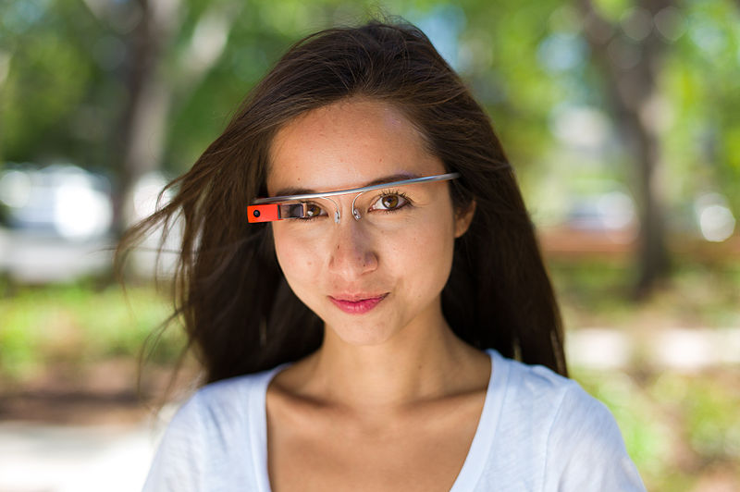
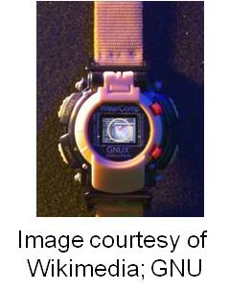
Alternative Designs for HIT
Where might alternative designs take us?
  Wearable computers
  Implantable chips
  Mobile solutions for mobile clinicians
Braun, M., 2015, CC BY-NC-SA 2.0)
(Mann, S., 2014, GNU FDL v 1.2)
Notes:
If you let your creative juices flow and begin to think about how Health IT can be designed in alternative ways (the second objective for this unit) and predict future avenues for innovation in Health IT (the last objective)—it can become both a fun and scary exercise. As you embark upon a new career in health IT, you will have users approach you with a variety of ideas of how to make something better—be it the layout of a screen, or a new technology that can be used to support smarter, easier, and safer healthcare. Many of those ideas will never come to fruition (thankfully so, as some may be downright bizarre)—but the point is that an important characteristic of someone in the Health IT field is to be open minded, have superior listening skills, and to embrace change. As we have discussed in prior units, change is not easy, but in Health IT change is part of the job. It is also important that you help others to embrace change and think creatively about new ways of doing things. That requires that you actually hear and comprehend what your users are telling you AND you must be an educator. So, listen to what your users are saying, assume the role of a teacher, and provide the pros and the cons to a suggested approach, and help them to better understand. Remember, a rising tide lifts all boats.
On the slide are some of the alternative designs for Health IT that are floating when this presentation was created. Wearable computers—like the watch-type device pictured here—is reflective of the efforts of designers that are trying to develop computing technology that works for a variety of different users. Other examples of wearable computers include sensors being woven into clothing (similar to NASA technology that astronauts have worn for some time) which can allow unobtrusive monitoring of changing physiologic parameters (such as temperature, pulse, glucose levels, etc.). Think about alternative uses of this wearable technology. Perhaps it can help the elderly to stay longer in their homes, by allowing care givers to track activities and monitor safety—similar to the old commercials “I have fallen and can’t get up.” Moving away from wearable computers and into architecturally embedded monitoring technologies—sometimes referred to as “smart homes” —can we help older patients to stay in the home longer by monitoring things like the stove being been left on, alterations in walking patterns, tracking if the refrigerator is being opened and closed (as a proxy for eating behaviors) and if an early stage dementia patient has started wandering outside of the home?
Of course the other side of the coin here is that many people have serious concerns about invasion of privacy—something that we must never forget. This sort of monitoring would require informed consent by the patient or the user. At the same time, maybe an elderly person might consider this to be a reasonable trade-off for being able to continue to live independently for a longer period of time. It is difficult to predict what sort of trade-offs may emerge as health IT continues to evolve.

Slide 6
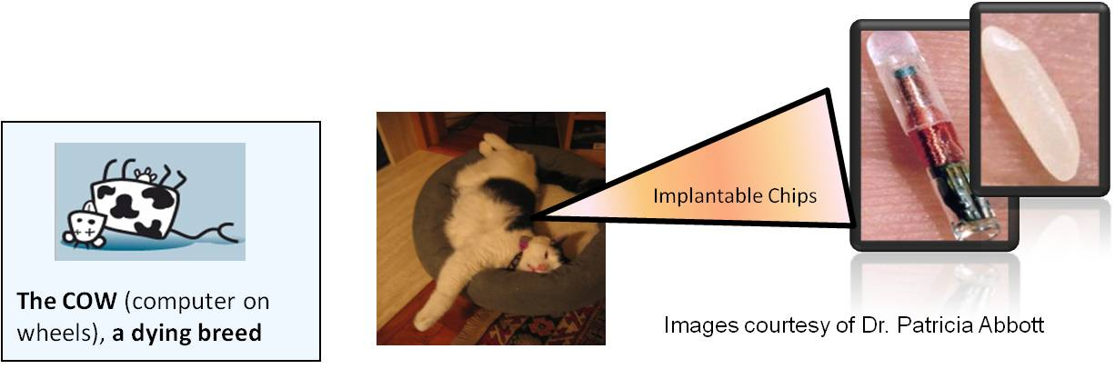
Alternative Designs for HIT (cont’d)
Where might alternative designs take us?
  I-phone like apps
  Advanced smart phones
  Robots
Notes:
Continuing in this vein—another quite controversial modality is the use of implantable chips. Many people have their pets chipped with a sensor that is about the size of a grain of rice, and there is an FDA approved device on the market called “Verichip” that is being used in humans.
There are pros and cons of course—chipped Alzheimer's patients who slip out undetected and become lost can be readily identified and returned. The “chipmobile” has been spotted in many elderly communities in Florida. There are upticks in its use in Japan in kidnap prevention strategies. Others may say that having an implanted chip with an encrypted ID that links to your secure online medical record may save your life if you collapse on the street and require emergency medical care. On the other hand, there are religious and cultural issues to be considered, privacy and security concerns, and other factors that seem to invoke the “creepiness factor” in many.
Mobile solutions for mobile clinicians is a very important area where Health IT innovation is needed. Initially, back in the day, clinicians were happy to get a computer in the nurses’ station for ready access to online resources. Quickly the need far outstripped the availability of a workstation in the nurses’ station. Numerous machines were needed and inevitably the queue at shift change and before and after rounding was nightmarish. Soon computing technology moved into the room, as a permanent placement, but the budget required for “one machine one patient” and the crowding of patient rooms shifted procurement in another direction. Computers on wheels or COWS (sometimes called WOWS or “Workstations on Wheels” so you can’t be accused of pushing a COW around) became the rage because mobile computers seemed the right thing to do. Unfortunately, the issues of pushing 60 pound computers around, dealing with disinfection (since computers can become vectors for transmitting bacteria from hands to keyboard then into another room and then on to another patient), and the challenge of charging the batteries has contributed to standard design COWS edging toward becoming a dying breed.
Smartphone and tablet apps for health are expanding by leaps and bounds. Perhaps the more interesting development is not so much in the apps, but the growth of the concept of an iPhone or iPad like architecture for housing the apps. Could we not have a Health IT architecture that allows such creativity to bloom—and then run on an open platform? There are already thousands of iPhone apps out there, but they only run on i-phones. We need an open app architecture. Taking the i-phone health apps idea on an open platform and combining it with smart phones (not just cell phones) seems to be a very promising area for future Health IT development.
Finally—Robots. Many healthcare institutions already have robots that deliver meal trays and supplies, fill pharmacy orders, and so on. However, there is a growth in using robots similar to the one pictured here to actually “visit” with a patient. This is not to imply that a robot can replace human contact and it is important to note that “robot” does not mean some scary sci-fi pile of metal! Bots can be great ways to connect folks with one another, allow a visiting nurse to “visit” without being there, allow a far away specialist to “see” a patient right in his home, etc. Bots can distribute medications, take vital signs, educate, and so on. A visiting nurse can visit every day instead of twice a week because of the loss of the need to travel and the saving in time.
Anyway, there are many areas where Health IT can grow.

Slide 7
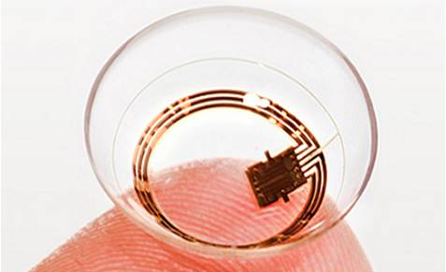
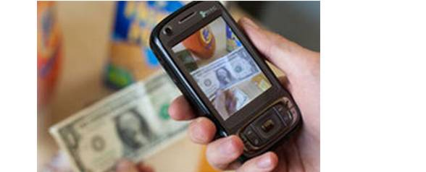
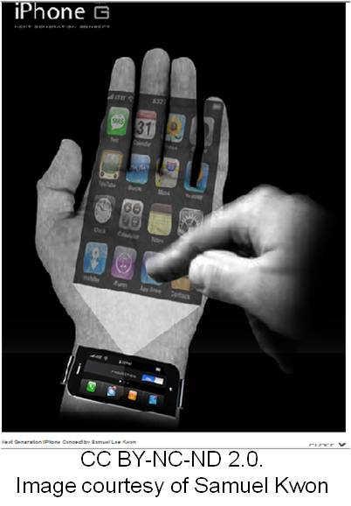
Other Ideas
(LookTel, 2012)
(SENSIMED Triggerfish® Sensor, 2014)
(Kwon, S. CC BY-NC-SA 2.0)
Notes:
A few other ideas of innovative health IT—at least at the time that this lecture was produced—are reflected here.
On the top left of the slide you will see an image of a device called LookTel. Supported with federal grants from the National Eye Institute at NIH, this device was built to combine the power and convenience of Smartphone technology with innovative artificial vision software. The device promises to be extremely useful for the blind or vision impaired. The Looktel device can be used to automatically scan and recognize objects such as money, packaged goods, CDs, DVDs, medication bottles, as well as buildings or landmarks. There are also interesting videos available on YouTube regarding LookTel that you may be interested in.
Again, consider the impact that this device, turned toward health, could do—read medicine bottles, turn a product label into an audio so a visually challenged person could determine the salt content of foodstuffs or distinguish between a can of cat food and a can of tuna. This is more fodder for your creative consideration.
In the top right of the screen is a contact lens with an embedded sensor, from Sensimed. Such devices can be used to track eye conditions such as intraocular pressure in glaucoma patients; Google recently announced a patent for a contact lens that can track blood sugar levels.
The image of the iPhone reflecting into the hand is a particularly interesting concept. Think about mobile clinicians and ways that an EHR can travel with them via their smart phones. This is a tricky design proposition—a mobile device needs to be small enough to travel with a mobile clinician, but big enough to be useable. Today’s smart phones have not solved this challenge yet. The problem with using a smart phone to access and review an EHR is in the “real estate.” In other words, the screen is very small and makes it extremely difficult, or impossible, for a provider to view all of the data needed to support high quality decision making. Ergo—the iPhone projection device! The view afforded to the user is no longer constrained to the smart phone screen. The user could project the EHR on to the wall, therefore decreasing the problem of that tiny “real estate.” We have a small mobile device that can now make the data contained within viewable.
Stop and think here for a moment, however, have we solved one problem and created another? If you display a patient’s chart on your hand or on a wall—what about privacy safeguards? Everyone in the viewing area can now see the patient’s medical record—which is in violation of confidentiality and privacy. The point here is that for all Health IT practitioners to consider, is that “fixing” one thing can often have downstream effects and those downstream effects can sometimes cause major issues and major safety and security concerns.
But the massive growth in digital connectivity, particularly in the baby boomer population, seems like a tremendous area for innovative Health IT.

Slide 8
General Data and Healthcare
How might “general data” contribute to health of persons and populations?
Biosurveillance
  “Collection and integration of timely health-related information for public health action achieved through the early detection, characterization, and situation awareness of exposures and acute human health events of public health significance.”
  (Fleischauer, Diaz, & Sosin, 2008)
Notes:
What are some of these intersections where publicly available data may be of use for public health? Many of you have probably heard the term biosurveillance; many of us became familiar with this term in relation to the fear of terrorist attacks. Fleischauer, Diaz, & Sosin (2008) define biosurveillance as a “collection and integration of timely health-related information for public health action achieved through the early detection, characterization, and situation awareness of exposures and acute human health events of public health significance.”
There are many different dimensions of biosurveillance, however, and while the goal is not to do a deep dive into this topic area—it is beneficial for you to think about how large sets of data can be used for health purposes.
Aside from biosurveillance efforts, most in healthcare are busy trying to get at the data that is generated as a natural product of healthcare services—particularly in relation to obtaining the data necessary to achieve our quality measures benchmarks. Remember: data is not like wine—it does not get better with age! So, there is quite an effort underway not only to get the data into health IT systems—but to get it back out, to make sense of it, and then to use what we discover to improve health and healthcare.
As we are digging for those nuggets of information, it is important to note that there are valuable indicators that are hiding in plain sight. Let’s think about purchasing patterns in a Walmart. When sales of cough medicine or Imodium go through the roof at the local Walmart—chances are that there is an illness running across the community. When school absenteeism skyrockets, it is a pretty good indicator of some sort of community illness. Digging a bit deeper, often spikes in school absenteeism has a direct correlation with increased adult work absenteeism—parents are either sick as well, or are forced to stay home with ill children. The point is that some of these types of patterns in seeming unrelated data can be related to changes in community health.

Slide 9
Infodemiology
“Infodemiology”
  “The Internet has made measurable what was previously immeasurable: The distribution of health information in a population, tracking (in real time) health information trends over time, and identifying gaps between information supply and demand.”
  Eysenbach G. (2009)
Notes:
Thinking back to those Walmart buying patterns, there is an actual term for this—Eysenbach coined the term “Infodemiology” in 2009. Dr. Eysenbach’s rationale for investigating this area is summed up like this: “The Internet has made measurable what was previously immeasurable: The distribution of health information in a population, tracking (in real time) health information trends over time, and identifying gaps between information supply and demand.”

Slide 10
Infodemiology defined
“Infodemiology can be defined as the science of distribution and determinants of information in an electronic medium, specifically the Internet, or in a population, with the ultimate aim to inform public health and public policy.”
Eysenbach G. (2009)
Notes:
Here is Eysenbach’s formal definition of infodemiology. It is “the science of distribution and determinants of information in an electronic medium, specifically the Internet, or in a population, with the ultimate aim to inform public health and public policy.”

Slide 11
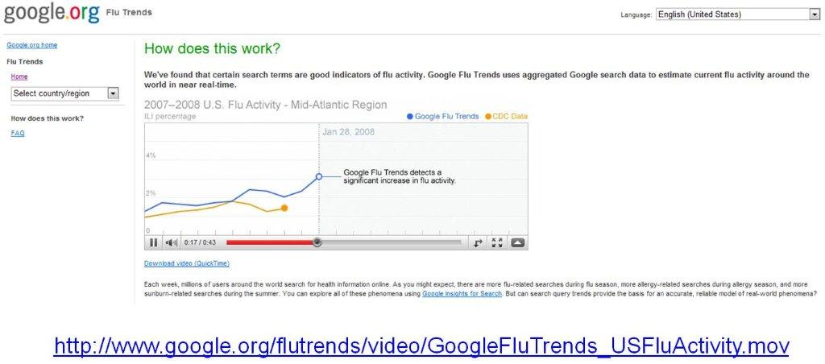
Infodemiology in Action
(Google Flu Trends, 2010)
Notes:
Let’s see infodemiology in action. Google Flu Trends was a really interesting example. Here is a paragraph from Google.org that explains how it worked:
“Each week, millions of users around the world search for health information online. As you might expect, there are more flu-related searches during flu season, more allergy-related searches during allergy season, and more sunburn-related searches during the summer. You can explore all of these phenomena using Google Insights for Search. But, can search query trends provide the basis for an accurate, reliable model of real-world phenomena?
We have found a close relationship between how many people search for flu-related topics and how many people actually have flu symptoms. Of course, not every person who searches for "flu" is actually sick, but a pattern emerges when all the flu-related search queries are added together. We compared our query counts with traditional flu surveillance systems and found that many search queries tend to be popular exactly when flu season is happening. By counting how often we see these search queries, we can estimate how much flu is circulating in different countries and regions around the world. Our results have been published in the journal Nature.”
However, according to David Lazer and Ryan Kennedy writing for Wired.com, Google Flu Trends “failed spectacularly—missing at the peak of the 2013 flu season by 140 percent.” Google eventually shut down the program. But this does not mean that this work is not valuable. In fact, the main point here is that as more and more data becomes available—there are huge needs for, and value in, pattern detection work. What sorts of health behaviors cluster together? Is there a link that may not be as obvious that we can explore to improve health delivery? Here is an example—and it has absolutely nothing to do with healthcare, but it does illustrate the concept.

Slide 12
Mining Data – Looking for Gold
Pattern detection
  What clusters?
  Data driven approaches – letting our data speak
Using the patterns to Improve
  Evidence versus habit
  Product placement
  Tradeoffs
  Unknown influencers
Notes:
You have probably heard the word data mining—and in essence, this is really what it is—but here is an example as one of those classic “market basket” analyses. As you listen to the story, think about how this could be applied in regards to health. Even though it is called “market basket analysis” think about health—not selling shoes.
Market basket analysis is really just another way to refer to what people buy and the patterns that may exist between buying one product and buying another product. An example may be in a convenience store. Maybe the owner wants to study what customers are buying so he can arrange products that are more likely to be bought if they are in close proximity to one another. Have you been to the grocery store and seen the placement of tomatoes, basil, and mozzarella cheese all together? This is not a coincidence.
Think about those candy displays in the grocery market—is it a coincidence that they are located at eye level for the child in the shopping cart while the parent is maximally stressed unloading groceries, looking for keys, and trying to find the credit card? Have you ever thought about why all those junky sweetened cereals are located where they are on shelves in the stores? They are certainly not located at the top of the shelves—they are placed right at kid eye level. It is about product placement to maximize sales. Anyway, back to the market basket analysis.
A convenience store manager wanted to see what people bought together. He studied the results of months of sales data from his bar code scanning database. So many things that clustered were obvious. People would buy bread and milk. People would buy soda and a hot dog or soda and a sandwich or a hot dog and chips or whatever, that’s pretty obvious. Understandable. But then the manager chanced upon another interesting find—which was the clustering of the purchase of beer with diapers. And this was quite unexpected. The manager found by conducting focus groups that the reason that these two elements clustered together in buying patterns was that mom had sent dad to the store to get diapers for the baby and dad could not pass by the beer display without picking some up.
Think about this from a business perspective. If you have diapers on sale and you find a strong relationship between the purchase of diapers and (more conventionally) let’s say—baby food—and then you place them together in the display but you don’t put them both on sale at the same time.
So in regards to health—could we turn this around and say what tests cluster that may just be an ordering habit and not evidence based? What health services do patients use or inquire about when they’re visiting a health facility for something else? What sort of tradeoffs are better for a diabetic who is craving a sweet? If you put your mind to it, you may think of a creative way to think about infodemiology, HIT and better health and better healthcare.

Slide 13
Health IT in the Future
Summary
Speculate on the relationship between HIT and health reform
Suggest alternative designs
Hypothesize how HIT may intersect with publicly available data to improve health (i.e. Point of Sale, Weather, GIS, foods, etc.)
Predict avenues of future innovations in HIT
Notes:
This concludes Health IT in the Future.
In summary, we can look back at the objectives and think about the journey that you have just taken.
We talked about the relationship between HIT and health reform, with discussion about the ACA, which was signed into law in 2010. To reach the goal to achieve more responsible, effective, and safe care—we must increase the adoption of health IT, a major driver within the ACA.
The “Center for Innovations” at the CMS came into being due to the ACA, as we discussed in this unit. This Center is expected to identify and test promising new models for delivering and paying for health care with a heavy reliance on innovative health IT.
Recall also that the AHRQ Center for Quality Improvement and Patient Safety is also deeply tied to the ACA—with the goal of identifying, developing, and disseminating knowledge in healthcare quality, safety, and value to a plethora of diverse stakeholders.
Hopefully you also remember the statement by Dr. Don Berwick—about “Journeys of care not fragments of care” and understand why we must begin to think about ways to stitch those fragments into a concerted whole.
We launched into the second objective for unit 11, regarding alternative designs for usable & supportive HIT, where the pleas for open mindedness and good listening skills were made. There are new inventions every moment, and there will continue to be. Examples such as increasingly smaller and smarter phones, wearable technology, imbedded monitoring, health apps, and so on were briefly mentioned.
Even as we rush headlong into HIT-enabled care—the point was made that we must continuously and rigorously weigh the costs and benefits, particularly the trade-offs and threats to privacy and security that may accompany innovation.
We have addressed the impact of reforming our health system and how Health IT can be utilized. The future of HIT was suggested in a series of images and challenges to a new way of thinking about health IT design and doing. Yes, some may be “out there” and maybe by the time you are watching this presentation, it will be old hat. No worries—this is a mind expansion exercise and is only constrained by your level of creativity and out of the box thinking.
We talked briefly about alternative designs and explored a bit in regards to using digital data from many different sources both inside and outside of healthcare to improve health. We hope you have enjoyed this unit and we are looking to the future to see the emergence of new Health IT to help us on our journey to better, safer, and more effective health.

Slide 14
Health IT in the Future
References
References
Centers for Medicare and Medicaid Services, Office of the Actuary, National Health Statistics Group, National Health Care Expenditures Data, January 2010. Available from: http://www.cms.hhs.gov/nationalhealthexpenddata/
Patient Protection and Affordable Care Act by United States Congress
Title III - Improving the Quality and Efficiency of Health. Available from: http://www.hhs.gov/healthcare/about-the-law/read-the-law/
Donald Berwick, MD, the administrator of the Centers for Medicare & Medicaid Services (CMS). America's Health Insurance Plans (AHIP) Medicare Conference. August 2010. Available from: http://www.healthcareitnews.com/news/berwick-says-fragmented-care-no-longer-option
Fleischauer, A., Diaz, P., & Sosin, D. (2008). Biosurveillance: A Definition, Scope and Description of Current Capability for a National Strategy. Advances in Disease Surveillance 2008;5:175.
Detmer, D., Bloomrosen, M., Raymond, B., Tang, P. Integrated Personal Health Records: Transformative Tools for Consumer-Centric Care. BMC Medical Information Decision Maker. 2008: 8: 45. Available from: http://www.ncbi.nlm.nih.gov/pmc/articles/PMC2596104/
Eysenbach, G. Infodemiology and Infoveillance: Framework for an Emerging Set of Public Health Informatics Methods to Analyze Search, Communication and Publication Behavior on the Internet. Journal of Medical Internet Research. Available from: http://www.jmir.org/2009/1/e11
Google Flu Trends. Available from: http://www.google.org/flutrends/
Looktel. What is LookTel? c2009-2011. Available from: www.looktel.com
Notes:
No audio.

Slide 15
Health IT in the Future
References (cont’d)
References
Google Inc. Google Insights for Search. Retrieved from www.google.com/trends/
Patrick, K., Griswold, W., Raab, F., Intille, S. Health and the Mobile Phone. Am J Prev Med. 2008 August; 35;2: 177-181. Available from: http://www.ncbi.nlm.nih.gov/pmc/articles/PMC2527290/?tool=pmcentrez
Roehr, B. Health care in US ranks lowest among developed countries. British Medical Journal, July 21. 2008.
Lazer, D. and Kennedy, R. (October 1, 2015). What we can learn from the epic failure of Google flu trends. Wired.com. Retrieved from http://www.wired.com/2015/10/can-learn-epic-failure-google-flu-trends/.
Images
Slide 3: Screenshot of healthcare.gov site. Courtesy healthcare.gov . Available from: http://healthcare.gov
Slide 4: Nurse, Patient, and Telehealth Device. Courtesy Dr. Patricia Abbott..
Slide 5: Image 1. Wrist Computer. Courtesy Wikimedia. Available from:https://commons.wikimedia.org/wiki/File:Stevemannwristcomp.jpg. GNU Open License.
Image 2. Google Executive Amanda Rosenberg modeling the Google Glass face mounted wearable computer. (2015). Retrieved from: https://commons.wikimedia.org/wiki/File:Google_executive_Amanda_Rosenberg_modeling_the_Google_Glass_face_mounted_wearable_computer.jpg
Slide 6: Cow, a Dying Breed, Cat, & Implantable Chip. Courtesy Dr. Patricia Abbott.
Notes:
No audio.

Slide 16
Health IT in the Future
References (cont’d – 2)
Images
Slide 7: Image 1. (2010). LookTel Looks to Help the Blind with Mobile Apps. Social Tech. Retrieved from: https://www.socaltech.com/looktel_looks_to_help_the_blind_with_mobile_app/s-0027630.html
Image 2. Sensimed AG. (2014). Corneal smart device, Triggerfish® Sensor [Online Image]. Retrieved from: http://www.sensimed.ch/.
Image 3. iPhone concept phone . Retrieved from: http://thecoolgadgets.com/iphone-next-g-concept-samuel-lee-kwon/
Slide 11: Image of Google Flu Trends website. Courtesy Google Flu Trends. Available: http://www.google.org/flutrends/
Notes:
No audio.

Slide 17
Working with Health IT Systems
Health IT in the Future
This material was developed by Johns Hopkins University, funded by the Department of Health and Human Services, Office of the National Coordinator for Health Information Technology under Award Number IU24OC00013. This material was updated in 2016 by The University of Texas Health Science Center at Houston under Award Number 90WT0006.
Notes:
No Audio. Ten Seconds of Silence.

