Slide 1
Networking and Health Information Exchange
Health Information Exchange
Lecture a
This material (Comp 9 Unit 10a) was developed by Normandale Community College, funded by the Department of Health and Human Services, Office of the National Coordinator for Health Information Technology under Award Number 90WT0003.
This work is licensed under the Creative Commons Attribution-NonCommercial-ShareAlike 4.0 International License. To view a copy of this license, visit http://creativecommons.org/licenses/by-nc-sa/4.0/
Notes:
Welcome to Health Information Exchange. This is lecture a, Concepts and Theory of Health Information Exchange.

Slide 2
Health Information Exchange Learning Objectives
Understand the purpose and importance of a Health Information Exchange strategy
Understand what a HIE is
Understand the components of a HIE
Explore some examples of HIEs
Notes:
The Objectives for this lecture, Health Information Exchange (HIE) lecture a are to:
Understand the purpose and importance of a Health Information Exchange strategy,
Understand what an HIE is,
Understand the components of an HIE, and
Explore some examples of HIEs.

Slide 3
Definition
Health Information Exchange enables the interoperable linkage of healthcare information across organizations within a hospital, an enterprise healthcare system, a region, or a nation.
HIE can be the ACT of sharing information (the verb) or it can represent the SYSTEM which facilitates the exchange (the noun)
Notes:
Health Information Exchange enables the interoperable linkage of healthcare information across organizations within a hospital, an enterprise healthcare system, a region, or a nation.
HIE can be the ACT of sharing information (the verb) or it can represent the SYSTEM which facilitates the exchange (the noun). HIE is used as both a verb and a noun interchangeably and often without warning!

Slide 4
Motivation
Issues of patient safety, effective and efficient care, quality care, lower cost care, and appropriate care all require the aggregation of all relevant data from and about a person, consolidated into a single real or virtual record – the patient-centric EHR.
Notes:
Issues of patient safety, effective and efficient care, quality care, lower cost care, and appropriate care all require the aggregation of all relevant data from and about a person, consolidated into a single real or virtual record – the patient-centric EHR.

Slide 5
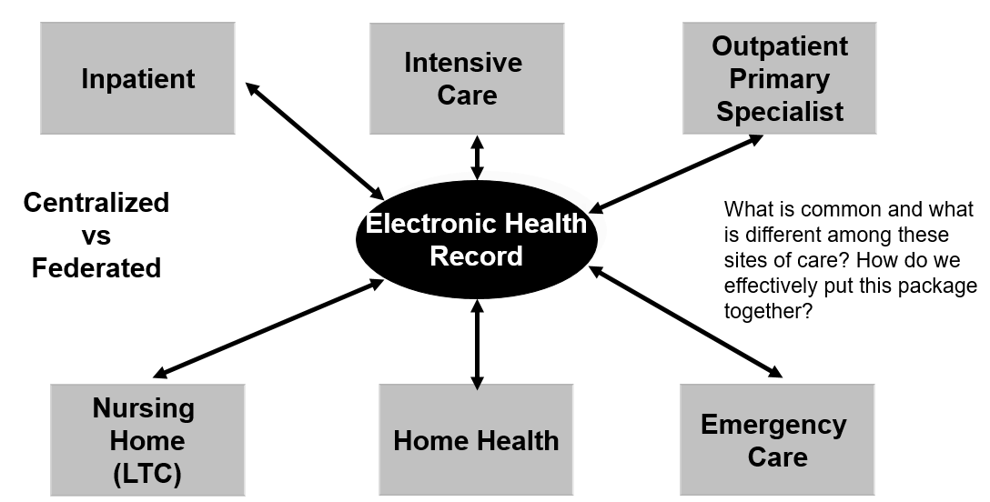
EHR Settings
Source: W. Ed Hammond, PhD.
Notes:
This figure graphically displays examples of settings that create data about a patient. Each of the sites or settings in this example both push data into and pull data out of the EHR. The timing of data exchange and the amount of data exchange depends on the type of the site and the purpose of the interchange.
What is common and what is different among these sites of care? How do we effectively put this package together?
A real patient-centric EHR brings the data together from each of the sources into a single, physical record. This approach is called a centralized EHR. If the data is left at the source and pulled whenever it is required, the result is a virtual EHR. This approach is called a federated EHR. These two approaches will be discussed in a later slide.
It is likely that each institution will have an EHR that meets its specific needs. I refer to that EHR as the Institutional-based EHR. Among other things, this EHR will be the source of the management of the care of the patient, for reporting and auditing, and for billing.
A nursing home, for example, will have an institutional EHR that will be different from the EHR of a hospital. However, for interoperability, it is important that data elements have the same coding and meaning and that they can be interchanged when necessary. Complete interoperability does not exist at present. Consequently, data elements must be mapped, often with a subsequent loss of information, between the different sites.

Slide 6
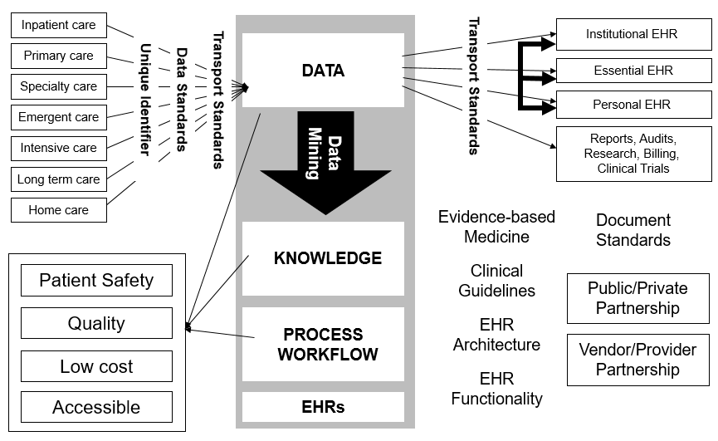
Data Aggregation from Multiple Sites
Notes:
This slide shows much of the same idea, but creates a bigger picture of many of the standards we have discussed in the previous lectures as well as introduces various views of the EHR. All of the sites of care contribute to the patient data set, using the set of standards that relate to data structure and data transport. That data in turn populates the institutional EHR which should be provider-centric – that is, its structure and functionality support the workflow and use by the provider, users, and others. The essential EHR is the name we use to identify the patient-centric EHR that represents the aggregation of data across the sites. We suggest an additional constraint. This Essential EHR contains only the data that contributes to a patient’s present and future care. This EHR will contain data from the past but only as it relates to the present and future care. The personal EHR is derived from the database but its focus is the patient. The block labeled DATA is called different names, including a Clinical Data Warehouse (CDW) or a Data Storage Repository.
The CDW is used for data mining to create new knowledge that is used with decision support algorithms, clinical guidelines, care plans, and other tools. EHR functionality standards are used to manage process workflow. Document standards are used for reports, audits, billing, and other such data presentation. These systems must be built from a public/private relationship as well as a vendor/provider relationship. Keys to success are privacy, security, trust and integrity of the systems.

Slide 7
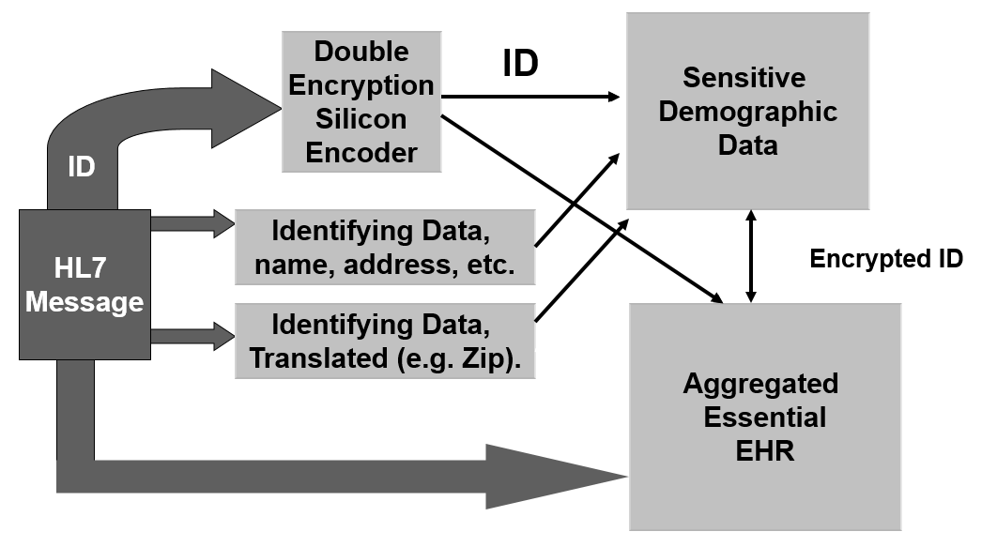
Download Process
Source: W. Ed Hammond
Notes:
Looking more closely at the data flow within an HIE, this figure illustrates data coming into the aggregated EHR, for example, using an HL7 message. That message should be encrypted. As the message is processed, the identifying data is stripped out and stored in a more secure, sensitive storage. Key to correct aggregation of data into the correct patient EHR is a unique, global person identifier, which unfortunately, does not exist at the present time in the U.S. Instead the identifying demographic data elements are used in an algorithm to try to guess the patient’s ID. The error rate is likely to be around 10% or higher. For real security, the external identifier of the person is encrypted in a double encryption algorithm that cannot be reverse decrypted and stored in silicon to make it inaccessible to hackers. This new secure algorithm is included in the aggregated essential EHR which is accessible to authorized parties, but is de-identified. The identifying data, such as name, DOB, address, gender, race and such, are included in the more secure area and are accessed only when necessary as part of the direct care process, This backwards linkage is necessary for many reasons and many occasions to communicate with the patient. Certain decision support algorithms need to access this data, but the data would not have to be shared with a human.

Slide 8
Issues for Shared EHR
Federated vs centralized
Primary reason for federated is privacy concerns
Centralized features:
Site deals with only one other site for send and receive
Integration and validation of data done only once
Better control of privacy and security
Better reliability
Better quality control
Many HIEs can offer centralized data with federated segregation of data
Natural disasters better managed with centralized control with backup in other region
Notes:
First, let’s discuss the model for the Essential EHR. There are often privacy and security concerns when discussing shared electronic health information. The concept of a large database that has patient information across the continuum of care, or the state or country, can raise significant privacy concerns for many people. So, often for reasons of privacy and control on the part of the institutions, the federated model has a lot of supporters. On the other hand, there are problems with the federated systems. Perhaps the most serious is access to that data in an emergency situation, such as Hurricane Katrina. Since the data is not centrally stored but maintained at each site, if one site fails then that data can be inaccessible. Even with off-site backups, the new gateways would have to be identified. With a federated system, each site would have to deal with n(n-1) sites, where as in a centralized system, the link is always to one system. The centralized approach offers better control of security and privacy, better reliability, and better quality control. Further, many HIE systems are designed to allow data to be stored in a centralized database but access is tightly controlled so that the features of a federated system are realized, without all of the downsides.

Slide 9
What is behind this model?
Standards
Infrastructure to support aggregation of data into a single patient record which requires …
Infrastructure to support a regional network
Infrastructure and linkage of regional networks to provide a virtual national network
A business case based on supported facts and includes a financial model that balances rewards with costs
A workable process that permits us to reach the destination in doable chunks
Understanding and creating the necessary linkages among stakeholders
State efforts blended into a common process that will support interoperability among states
Notes:
What must exist to support an HIE?
Standards – what we have discussed in this component,
Infrastructure to support aggregation of data into a single patient record which requires …
Infrastructure to support a regional network
Infrastructure and linkage of regional networks to provide a virtual national network
A business case based on supported facts and includes a financial model that balances rewards with costs
A workable process that permits us to reach the destination in doable chunks
Understanding and creating the necessary linkages among stakeholders
State efforts blended into a common process that will support interoperability among states

Slide 10
These views must serve
Real-time connectivity to provide appropriate and controlled access to aggregated patient data.
Disease registries permit the monitoring and assurance of high quality care.
Research databases are derived for specific purposes and for specific periods of time.
Reimbursement is derived from clinical data, ideally in real time.
Accreditation, credentialing and statistical reporting are derived products.
The data warehouse contains all data for legal and archiving purposes.
Support consumer driven healthcare
Mandatory reporting such as immunizations, HAI, etc.
Notes:
An HIE must serve ….
Real-time connectivity to provide appropriate and controlled access to aggregated patient data.
Disease registries permit the monitoring and assurance of high quality care.
Research databases are derived for specific purposes and for specific periods of time.
Reimbursement is derived from clinical data, ideally in real time.
Accreditation, credentialing and statistical reporting are derived products.
The data warehouse contains all data for legal and archiving purposes.
Support consumer driven healthcare
Mandatory reporting such as immunizations, Healthcare Acquired Infections (HAI), etc.

Slide 11
Consumer value
Appropriate care is enhanced by complete set of data about the patient, particularly when combined with decision support
Patient safety is enhanced by complete and timely data at point of care
Effective and appropriate treatment
Patient satisfaction and trust is enhanced by a care giver who knows all about the patient, without the patient having to remember and repeat a full medical history
Notes:
What’s in it for the consumer?
Appropriate care is enhanced by a complete set of data about the patient, particularly when combined with decision support,
Patient safety is enhanced by complete and timely data at point of care,
Effective and appropriate treatment, and
Patient satisfaction and trust is enhanced by a care giver who knows all about the patient, without the patient having to remember and repeat a full medical history.

Slide 12
Consumer value (2)
Personal health data that is timely and understandable by the consumer
Understanding importance and significance of data
Personal health plans
Understanding treatment options
Tradeoffs between risks of death and quality of life
Manage event flow related to health
Appointments
Drug management
Manage cost of care
Inform and manage expectations of care
Provide encouragement for good health
Notes:
The following are also advantages for the consumer.
Personal health data that is timely and understandable by the consumer,
Understanding the importance and the significance of data,
Personal health plans,
Understanding treatment options including the tradeoffs between risks of death and quality of life
Manage the event flow related to health such as doctors’ appointments, drug management, costs of care, and expectations of care, and
Provide encouragement for good health.

Slide 13
More consumer value
People over the age of 65 have on average 3 or more chronic diseases. Disease management means a higher quality of life as well as a longer life. Proper disease management means complete data about the patient as well as having and using the appropriate knowledge about the patient and the disease.
Proper management of health and constant monitoring of health extends independent home living.
Notes:
And continuing …
People over the age of 65 have on average 3 or more chronic diseases. Disease management means a higher quality of life as well as a longer life. Proper disease management means complete data about the patient as well as having and using the appropriate knowledge about the patient and the disease.
Proper management of health and constant monitoring of health extends independent home living.

Slide 14
Regional Health Information Organizations
Regional collaboration of multi-stakeholder organizations working together to connect healthcare communities with the goal of improving quality of care, safety and efficiency
Typical objectives
Develop community-wide health information exchange
Create healthcare portal with interoperable applications
Create a training and support infrastructure to ensure adoption of applications
Engaging payers in programs that align incentives appropriately
Notes:
The first implementations of HIE were called Regional Health Information Organizations (RHIOs). In some places, the name Health Information Exchange Organization (HIEO) is used. They mean the same thing.
An RHIO is a Regional collaboration of multi-stakeholder organizations working together to connect healthcare communities with the goal of improving quality of care, safety and efficiency.
Typical objectives are to develop a community-wide health information exchange; to create a healthcare portal with interoperable applications; to create a training and support infrastructure to ensure adoption of applications, and to engaging payers in programs that align incentives appropriately.
There are several challenges in implementing a RHIO, such as financial sustainability, achieving a critical mass of data to provide value, and getting many disparate partners, who may also be competitors, to participate. The benefits to patients and others are significant, however, and work continues to implement RHIOs across the country in various settings and with many different objectives.

Slide 15
Setting the boundaries
Patients receive care at multiple sites of care, independent of any geographical or legal boundary.
Even within one family, the members have different geographically boundaries for care.
On the average, an adult person receives their care from 5 different sites.
Notes:
There are really no boundaries that encapsulate the area of care for a population. If you were to draw a boundary around the sites where a receives care, and one around where the spouse receives care, the boundaries would be different. People who live on a state boundary are likely to receive some care in one state and more care in the other state. Even internationally, persons receive care in multiple countries. Within Europe, people routinely cross country boundaries for care. People from around the world come to the U.S. for care. So, in order to aggregate all data about a single patient, interoperable connectivity must be enabled across all boundaries. For a state, whatever fabric is woven using the regional models, it must provide a framework to accept and share data across all boundaries.
Focusing just on the United States, that means that whatever system is in place to support HIE, it must be at a national level.

Slide 16
Nationwide Healthcare Information Network (NwHIN)
To provide a secure, nationwide, interoperable health information infrastructure that will connect providers, consumers, and others involved in supporting health and healthcare.
E-health information to follow the consumer, be available for clinical decision making, and support appropriate use of healthcare information beyond direct patient care so as to improve health
De-identified regional data can be analyzed nationally in aggregate. There is a proposed national MPI which would permit authenticated and authorized access to RHIOs for legal health-related purposes, but patient matching algorithms are the industry standard.
Security and privacy are top priorities.
Notes:
The resulting infrastructure, then, is some form of a nationwide healthcare information network. There are several models and activities that attempt to enable this infrastructure, and they will be discussed in subsequent slides. The purpose of a national healthcare information network is :
To provide a secure, nationwide, interoperable health information infrastructure that will connect providers, consumers, and others involved in supporting health and healthcare.
E-health information to follow the consumer, be available for clinical decision making, and support appropriate use of healthcare information beyond direct patient care so as to improve health
De-identified regional data can be analyzed nationally in aggregate. A national patient identifier was included in the HIPAA law, but will likely not be implemented. Patient matching algorithms and processes are the current state of the industry and will continue to be the preferred method for finding patient information.
Security and privacy are top priorities.

Slide 17
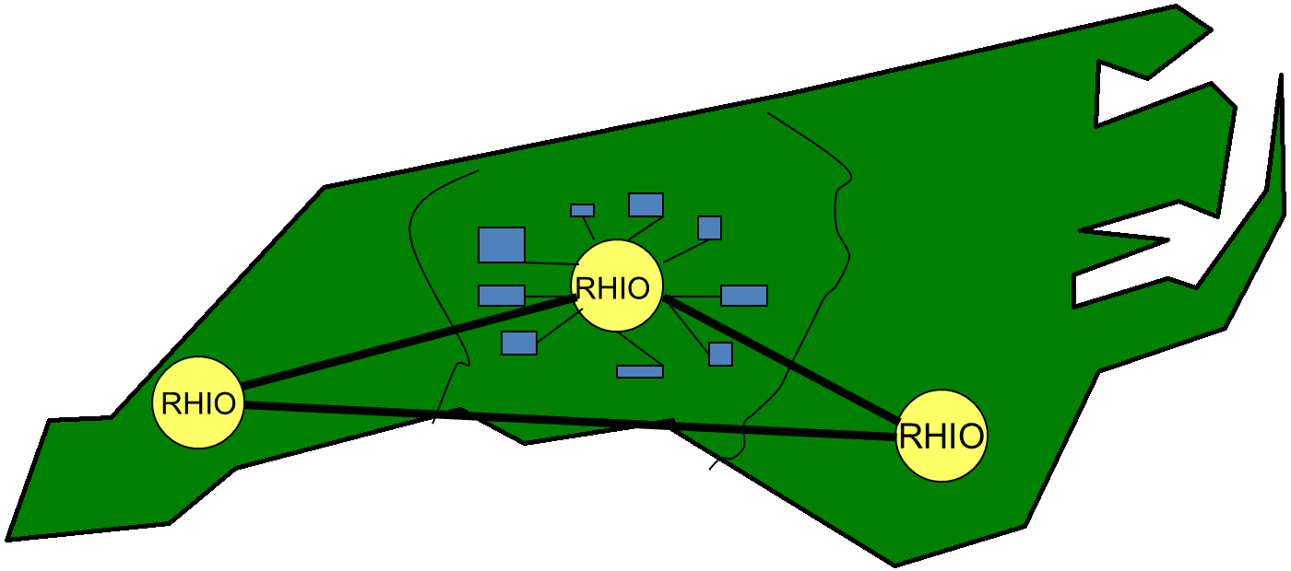
Regional Healthcare Information Organizations
Each RHIO provides backup for other RHIOs.
MPI identifies home RHIO
Source: W. Ed Hammond
Notes:
This slide shows one theoretical model in which many RHIOs are interconnected to create and enable a national healthcare information network. In this hypothetical example, the state of North Carolina is supported by 3 regional healthcare information organizations, each of which supports a population of 3 to 5 million persons – an easily scalable model.
The population of the U.S. is just over 300 million persons. Using the figure of 3-5 million per RHIO, the U.S. would be easily covered by 100 such RHIOs.
Each RHIO would provide backup for other RHIOs within some geographical proximity. In this example, one RHIO might be in Charlotte, one in the Research Triangle, and one in the coastal region, say Wilmington. Each RHIO would backup the other two, and could immediately take over functioning in case of a disaster. Within well-defined geographical boundaries, all patient data would be aggregated into a patient-centric record within a centralized database.
If a patient is seen outside their assigned area, that data would be sent to their “home” database. Likewise, the clinic outside a geographic area could request data in real time from the home RHIO.
One automatic way of knowing the home RHIO would be to assign each person an identifier that would consist of the RHIO ID + the unique patient identifier. The same strategy would work globally, if global identifiers were assigned.
The RHIOs would be operated by trusted, reliable organizations.

Slide 18
Regional Center
Accommodates 3 to 5 million persons
Contains aggregated data for EHR
Is a local ( to the region) database
Available 24/7
Contains linkages to other centers so patients crossing boundaries of regions can be aggregated
De-identified data available for local or global queries and analysis
Notes:
In summary, a regional center would:
Accommodate 3 to 5 million persons,
Contain aggregated data for an Essential EHR,
Be local to the region database,
Be Available 24/7,
Contain linkages to other centers so patients crossing boundaries of regions can be aggregated, and
Have de-identified data available for local or global queries and analysis.

Slide 19
Nationwide Health Information Network [NwHIN]
Initiative of the Office of the National Coordinator for Health Information Technology
Purpose is to tie together health information exchanges (HIEOs)
Assigns OID to participating organizations
Built on Open Source code using Java platform
Public/private venture
Notes:
The Nationwide Health Information Network (NwHIN) is an initiative of the ONC. Its purpose is to tie together information exchanges using a Java platform and Open Source code. Participating organizations are assigned an Object Identifier (OID) to identify them as a trustee entity. This initiative is supported by both public and private entities.

Slide 20
CONNECT
CONNECT is an open source software package that implements the NwHIN architecture.
Federal agencies collaborated through the Federal Health Architecture (FHA) to create the CONNECT package.
Notes:
CONNECT is an open source software package that implements the NwHIN architecture.
Federal agencies collaborated through the Federal Health Architecture (FHA) to create the CONNECT package.

Slide 21
The DIRECT Project
The DIRECT project specifies a simple, secure, scalable, standard-based implementation guide for users to send authenticated, encrypted health data directly to known, trusted recipients over the Internet.
DIRECT Project is a collaborative whose stakeholders represent over 50 provider, state, HIE, and HIT vendor organizations.
DIRECT accomplishes this using familiar protocols, such as SMTP (email) with S/MIME (encryption).
DIRECT is an excellent option for secure communication between providers, particularly those who are not connected to an HIE via CONNECT.
Notes:
The DIRECT Project was launched in March 2010. The DIRECT project specifies a simple, secure, scalable, standard-based implementation guide for users to send authenticated, encrypted health data directly to known, trusted recipients over the Internet. The DIRECT Project is a collaborative whose stakeholders represent over 50 provider, state, HIE, and HIT vendor organizations. The DIRECT Project addresses key Phase I requirements for Meaningful Use.
DIRECT is an attractive solution for communicating protected health information because it uses familiar email protocols and therefore has a low cost of entry and is easily used by nearly any provider.

Slide 22
State HIEs
The State Health Information Exchange Cooperative Agreement Program was designed to promote HIE and advance information sharing across the health care system.
Long term goal was to enable a nationwide HIE and interoperability.
In total, 56 states, eligible territories and State Designated Entities received awards.
Program ended in 2014
Notes:
The State Health Information Exchange Cooperative Agreement Program was designed to promote HIE and advance information sharing across the health care system. The long term goal was to enable a nationwide HIE and interoperability. In total, 56 states, eligible territories and State Designated Entities received awards. The program ended in 2014.
As work progresses, each state appears to be doing its own thing. The approaches differ from state to state. Although there are coalitions among a few states, a common approach has not happened, creating problems for patients who are seen across state boundaries. Projects like the Sequoia Project are designed to facilitate exchange between these disparate state approaches.

Slide 23
Sequoia Project
A group of federal agencies and non-federal organizations have created a collaboration, known as the Sequoia Project.
Its mission and purpose is to improve patient care, streamline disability benefit claims, and improve public health reporting through secure, trusted, and interoperable health information exchange.
Notes:
A group of federal agencies and non-federal organizations have created a collaboration, known as the Sequoia Project.
Its mission and purpose is to improve patient care, streamline disability benefit claims, and improve public health reporting through secure, trusted, and interoperable health information exchange.
Members of the Sequoia project are growing and include CMS, the Department of Veterans Affairs, several state HIEs, and large integrated delivery networks.

Slide 24
Health Information Exchange Summary
In this lecture we have looked at Health Information Exchanges. We have examined the concept, purposes and value of HIEOs.
We have looked and several different models for realizing HIEOs or RHIOs.
We have looked at several federally- initiated programs.
Notes:
This concludes lecture a of Health Information Exchange.
In this lecture we learned about Health Information Exchanges. We have examined the concept, purposes and value of HIEOs.
We have looked and several different models for realizing HIEOs or RHIOs.
We have looked at several federally- initiated programs. Those programs include NwHIN, CONNECT, DIRECT, NHINE, and the various State HIE Programs.

Slide 25
Health Information Exchange References – Lecture a
References
No references were used in this lecture.
Images
Slide 5: Source – W. Ed Hammond, PhD., 2012.
Slide 6: Source – W. Ed Hammond, PhD., 2012.
Slide 7: Source – W. Ed Hammond, PhD., 2012.
Slide 17: Source– W. Ed Hammond, PhD., 2012.
Notes:
No audio.

Slide 26
Health Information Exchange Lecture a
This material was developed by Duke University, funded by the Department of Health and Human Services, Office of the National Coordinator for Health Information Technology under Award Number IU24OC000024. This material was updated by Normandale Community College, funded under Award Number 90WT0003.
Notes:
No audio

