Slide 1
Networking and Health Information Exchange (HIE)
Health Information Exchange
Lecture b
This material (Comp 9 Unit 10b) was developed by Normandale Community College, funded by the Department of Health and Human Services, Office of the National Coordinator for Health Information Technology under Award Number 90WT0003.
This work is licensed under the Creative Commons Attribution-NonCommercial-ShareAlike 4.0 International License. To view a copy of this license, visit http://creativecommons.org/licenses/by-nc-sa/4.0/
Notes:
Welcome to Networking and Health Information Exchange, Health Information Exchange. This is lecture b, Practical Health Information Exchange

Slide 2
Health Information Exchange Learning Objectives
Clarify that HIE is both a noun and a verb.
Identify benefits/risks of HIE for patients, providers, government and specific benefits for rural health.
Describe the push and pull methods of moving data and give an example of each.
Identify benefits/risks of HIE for patients, providers, government
Contrast the difference between syntactic and semantic interoperability.
Notes:
Objective for this component covering Health Information Exchange are:
Clarify that HIE is both a noun and a verb.
Identify benefits/risks of HIE for patients, providers, government and specific benefits for rural health.
Describe the push and pull methods of moving data and give an example of each.
Identify benefits/risks of HIE for patients, providers, government
Contrast the difference between syntactic and semantic interoperability.

Slide 3
Objectives (cont.)
Describe how the major advantage of the centralized model over point to point interoperability.
Identify the various acronyms describing the structure of HIE: NwHIN, PCMH, ACO, IHE, FHIR.
Understand the features to ask an EHR vendor provide effective HIE.
Discuss future trends for HIE.
Notes:
Describe how the major advantage of the centralized model over point to point interoperability.
Identify the various acronyms describing the structure of HIE: NwHIN, PCMH, ACO, IHE, FHIR.
Understand the features to ask an EHR vendor provide effective HIE.
Discuss future trends for HIE.

Slide 4
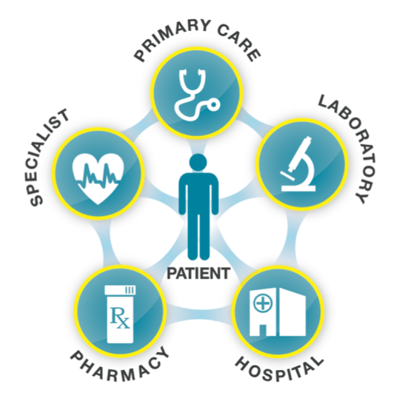
Health Information Exchange (HIE)
Health care providers and patients can
appropriately access and securely share
personal vital medical information electronically.
Goals:
Avoid readmissions
Avoid medication errors
Improve diagnoses
Decrease duplicate testing
Source: Healthit.gov
Notes:
Electronic health information exchange (HIE) allows doctors, nurses, pharmacists, other health care providers and patients to appropriately access and securely share a patient’s vital medical information electronically, thus improving the speed, quality, safety and cost of patient care.
Appropriate, timely sharing of vital patient information can foster better informed decision making at the point of care and allows providers to:
Avoid readmissions
Avoid medication errors
Improve diagnoses
Decrease duplicate testing
Patient engagement is a major overarching goal as communication though health information exchange can help motivate patient behavior with managing wellness as a goal.

Slide 5
Defining HIE Verb and Noun
Mobilization of healthcare information electronically across organizations (Verb)
Entity that facilitates the exchange (Noun)
Goal: facilitate access to and retrieval of clinical data to provide safer and more timely, efficient, effective, and equitable patient-centered care.
Notes:
A more formal definition of Health information exchange (HIE) is the mobilization of healthcare information electronically across organizations within a region, community or hospital system. In practice the term HIE may also refer to the organization that facilitates the exchange.
Health Information Exchange allows health care professionals and patients to appropriately access and securely share a patient’s vital medical information electronically.
The goal of HIE is to facilitate access to and retrieval of clinical data to provide safer and more timely, efficient, effective, and equitable patient-centered care. HIE is also useful to public health authorities to assist in analyses of the health of the population.
http://en.wikipedia.org/wiki/Health_information_exchange_(HIE)
http://www.healthit.gov/HIE

Slide 6
Moving data: Push/Pull
Push: secure sending of information between two known entities
Direct Project
Pull: secure accessing of information that involves a query and a response
CONNECT
Notes:
At its simplest level, HIE requires the capability to "push" a message securely from one party to another. This involves sending a message or document - such as a laboratory result or an e-prescription - from one organization to another. Another metaphor would be sending an email message. This is considered "direct," "point-to-point" or "transactional" exchange. In healthcare, the Direct Project, launched in 2010 as part of the NwHIN, focuses on the technical standards and services necessary to securely push content from a sender to a receiver and not the actual content exchanged.
A secure accessing of information that involves a query and a response describes the “pull” transmission. The query requests information about a patient, and the response is the retrieval of clinical information about the patient or information pointing to where the clinical data can be found. Using a search engine, such as Google, to conduct a web search is an example of a pull transaction.
CONNECT is a software solution that organizations can use to securely link their existing health IT systems into the health information exchanges.
http://www.health.state.mn.us/divs/hpsc/ohit/hieguidance/assesslandscape.html
http://www.healthit.gov/policy-researchers-implementers/direct-project
http://www.connectopensource.org/about/faq#whatisconnect

Slide 7
Direct and Connect
Point to Point
Specifies a simple, secure, scalable, standards-based method to send authenticated, encrypted health information directly to known, trusted recipients over the Internet, using third parties such as DirectTrust
Broader – multiple entities
Open source software gateway that allows health organizations to securely exchange health-related information connecting multiple stakeholders.
http://directproject.org/
http://www.connectopensource.org
Notes:
The DIRECT Project launched in March 2010 is a part of the Nationwide Health Information Network. It specified a simple, secure, scalable, standards-based way for participants to send authenticated, encrypted health information directly to known, trusted recipients over the Internet.
The Direct Project focuses on the technical standards and services necessary to securely push content from a sender to a receiver, considered point-to-point exchange. Direct Project participants include EHR vendors, medical organizations, systems integrators, integrated delivery networks, federal, state and regional health information organizations, HIE organizations, and HIE consultants.
CONNECT is another path to health information exchange. It is an open-source, flexible platform for secure HIE using Sequoia Project standards and governance as a framework. The Federal Health Architecture (FHA) has made CONNECT available to the public free of charge and it is open for continued software development, improvement and contribution.
For more information about DIRECT or CONNECT, visit the links provided here: http://www.connectopensource.org http://directproject.org/
http://www.healthit.gov/sites/default/files/pdf/fact-sheets/onc-office-of-interoperability-and-standards.pdf

Slide 8
Benefits of HIE: Providers
Emergency Care
Public health reporting and monitoring
Improved Care / Fewer Medical Errors
Clinical Decision Support
Tracking Access to Information
Less Redundant of Unnecessary Services
Reduced Costs
Notes:
Interoperable health records allow health care providers to access patient data, even when patients are unable to explain their medical history, such as when they are injured. In the event of a disaster, such as a hurricane, health information stored in electronic form is safer than paper records.
Public Health monitoring makes it possible to achieve syndromic surveillance and early alerts in the case of a disease outbreak or terrorist event.
From the provider’s standpoint, considering a patient’s complete health picture can lead to improvements in care and fewer errors. This allows for responsible choices about treatments and medication, making certain new modalities won’t interact badly with the patient’s existing treatment regimen, and reducing redundant services. For example, a provider able to access a patient’s record can see current x-rays and lab test results, so there is no need to repeat these services
Enhanced clinical decision support is a key component of HIE. Data collected through reporting, is aggregated and analyzed to identify best practices that assist point of care decision making. And because the records are stored electronically, there are safeguards in place that log the identity of those who access a patient’s record, the date of access, reason for access and the types of information accessed. Protecting patient’s privacy is critical. Because HIE can increase the efficiency of delivering care, it has the potential to reduce costs.
http://www.ms-hin.ms.gov/Sub/Pages/Benefits.aspx

Slide 9
Benefits of HIE: Patients
Consumer Education and Patient Involvement
Improved payment coordination
Improved clinical outcomes
Improved transitions of care
Reduced or eliminated duplicate procedures
Improved visit experience and satisfaction
Notes:
Another benefit of HIE is the ability to involve patients through access to their history and health-related educational materials. The consumer portals being established allow a new avenue for communication between providers and patients. And patient engagement on all levels is an overarching goal of Health Information Exchange (HIE).
HIE facilitates efficient data exchange for claims processing for payment coordination.
Providers are able to bring about improved clinical outcomes when they have a clear picture of all of a patient’s medical information to guide decision-making.
When a patient is moved between facilities, the transition is eased by the electronic access of the patient’s chart across facilities. The documentation of all previous tests and procedures eliminates the need to repeat them at the new facility. These efficiencies contribute to the overall patient satisfaction.

Slide 10
Benefits of HIE: Government/Public Health
Improved understanding of patients’ clinical needs
Improves Public Health Reporting /Monitoring
More timely access to public health and population health data
Supports Medicaid in developing programs to improve health of residents
Source: District of Columbia Department of Healthcare Finance
Notes:
From the perspective of Government, Health Information Exchange shapes a greater understanding of the needs of patients in a given population. Because interoperability permits efficient data exchange, public health reporting and monitoring is improved and agencies and providers have more timely access to the population health data. The trends seen in this data help to shape the development and prioritization of programs to improve the health of residents.

Slide 11
Benefits of HIE- Rural
Timely real-time access to health information
Decreased travel time for patients /families
Extended access to remote clinicians, pharmacists
Efficient transfer for services not offered locally
Efficient local care after intense care in a tertiary hospital
Notes:
Health IT will be especially beneficial to rural America. In rural areas where distances between clinics are great and specialists are often few and far between, health IT can:
Give health care providers instant access to information they need to make timely, vital decisions and save lives
Decrease travel time for patients and their families
Enable rural hospitals to utilize remote clinicians, pharmacists, and staff members to improve and extend access
Facilitate efficient transfer to other facilities for vital services not offered locally
Facilitate efficient local care after intense care in a tertiary hospital by enabling patients to get care near their families and primary care providers

Slide 12
Patient Consent
State and federal law decides if patents have the option to opt in or out of exchange:
Opt-in State
None of your data is shared unless you opt-in to the program
Opt-out State
Patient’s data automatically is available to the HIE unless they opt-out
Notes:
Patient consent is a concept of considerable debate. State law or HIPAA decide how patient consent is managed in each state. In an opt-out State, patient’s data automatically is available to the HIE unless they opt-out. In an opt-in State, none of your data is shared unless you opt-in to the program. Some of the questions this raises:
In an opt-in state the patient has to specifically opt in to participate in health information exhcange. In an emergency situation, for example, this can be problematic. If patient data is stored on an HIE, and the emergency provider has not been given specific consent from the patient, then they would likely not be able to access important information at a time of need. Often a feature called “break the glass” is available that can allow access to this information, but only if it is in fact stored in the HIE. Some implementation of HIE do not store information where a patient has not opted in.
In an opt-out state, the patient requests others NOT have access to their data. Data is still stored, but no one has access to it, except in a case of “Break the glass.”
Partial opt-out is hard to do technically, but easy to understand the reasons some patients want it. For example, a pregnant youth may choose to withhold information from parents or an adult in mental health counseling may want this information hidden from an employer, yet may still want a future provider to know.
The right time to talk about opt-in opt-out is when advanced care is discussed, rather than at admission.

Slide 13
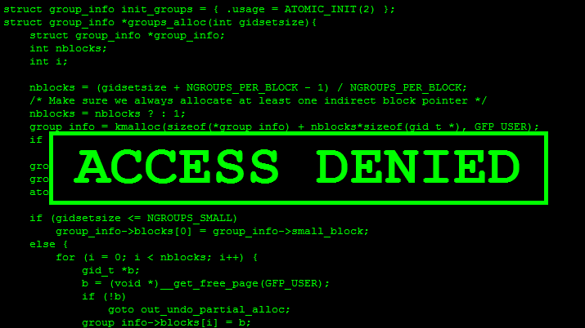
Risks of HIE
Identity Theft
Hackers
Errors
Complexity
Cost
Notes:
EHR’s are designed with stringent security measures to protect health information. In this era of hackers and data breaches, health records are at the same risk that exists in other areas, such as defense or finance. The risk of Identity theft is magnified with digital files because a breach can affect a greater number of records.
Interoperable EHRs have great potential to enhance care, but they also carry potential for errors. Data entry by providers must be accurate and in the right fields. The system can provide checks and balances to make accuracy easier to attain.
This information was developed by the Consumer Engagement and Education Collaborative of the Health information Security and Privacy Collaboration (HISPC) project, funded by the ONC.
Government involvement in oversight of HIEs, adds layers of complexity and additional time to make progress. All stakeholders, the Federal and State governments, the healthcare providers and patients have a role in building HIE capabilities and success. There are choices to be made as to which Accountable Care Organizations (ACOs) and HIE providers and their patients will choose to engage with. Finally, the technology costs are very high. And it takes time to sift through all of the priorities to implement what is needed and necessary vs what is possible.
Although these risks are present, they can be mitigated very effectively in an HIE, often more effectively than paper-based systems.

Slide 14
Defining Interoperability
Interoperability involves exchanging key pieces of health information securely, with the goal of being to obtain and share the right information in the right context.
Meaningful Use data set:
http://ccda.sitenv.org/Common+MU+Data+Set
Vocabulary & Code Sets (Snomed, ICD9 or10)
Content Structure
Transport
Security
Services
Notes:
As we moved from meaningful use stage 1 to stage 3, the focus has shifted from information capture to the sharing of information with other providers, patients and public health agencies. This is accomplished though interoperability, which involves exchanging key pieces of health information securely, with the goal being to obtain and share the right information in the right context.
http://www.healthit.gov/public-course/interoperability-basics-training/HITRC_lsn1069/wrap_menupage.htm
The Office of the National Coordinator for Health Information Technology (ONC) defined a common Meaningful Use data set for reporting for all summary of care records, care transitions, discharges, and patient access. This Meaningful Use Common Data Set, can be accessed by selecting the link on this page. For exchange purposes, there is an ONC-defined framework for a set of building blocks that support system interoperability. These building blocks include:
· Vocabulary & Code Sets
· Content Structure
· Transport
· Security
· Services
http://www.healthit.gov/public-course/interoperability-basics-training/HITRC_lsn1069/wrap_menupage.htm

Slide 15
Healthcare Interoperability: Terms
Interoperability: The ability of diverse systems to work together.
Two types of Interoperability
Syntactic: The ability of computer systems to communicate and exchange data.
Semantic: The ability of computer systems to meaningfully interpret the information exchanged.
Notes:
To further refine our definition of interoperability, it revolves around the ability for diverse systems to work together.
There are two levels of interoperability.
Syntactic Interoperability refers to moving computer systems from communication to exchange of discrete data. To effectively accomplish this, industry standards in vocabulary have been developed.
Semantic Interoperability involves data interpretation. Discrete data populates your flow sheets and organizes a series of isolated numbers so they can be charted and aggregated by patient. Organizing the data in this way is Semantic Interoperability, where the information is interpreted so it can be usable. For data exchange, semantic interoperability is of key importance.

Slide 16
Interoperability: Chaotic
Notes:
In attempting to achieve point to point interoperability, many vendors utilize quick-to-implement, easy-to-replicate systems. Unfortunately, these become a nightmare to support, especially for the sites. Because of this, point to point is often seen as a chaotic model. The centralized model is generally preferred because if a system updates and goes down in the point to point model, 20 sites may subsequently be down. Some HIEs now have over 200 sites, so this could be a major problem.

Slide 17
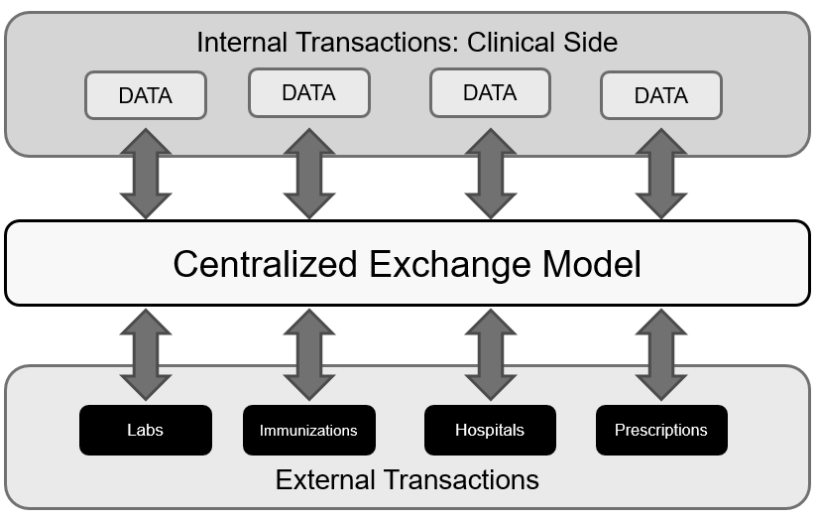
Interoperability: Structured
Notes:
While this graphic tends to over-simplify the nature of the interoperability transactions and their complexity, it does highlight a scalable, modular approach to information exchange as well as a standards-based approach.
In this model, if a lab system happens to go down after an update, the problem is isolated and doesn’t affect multiple sites.

Slide 18
Big Picture: NwHIN Nationwide Health Information Network
Current pronunciation: “New HIN” - Also known as the NHIN
NwHIN Connect – traditional view of inter-connected cells
NHIN Direct – aka Direct Project, considered “NwHIN” lite; idea is ease of adoption
ARRA funded – American Recovery and Reinvestment Act
Syndromic Surveillance - 9/11/2001 as a driving factor
Notes:
Originally, when the American Recovery and Reinvestment Act (also known as ARRA) defined Government entities, the National Health Information Network was known as the N-H-I-N, (pronounced “nin”). But then this was found to have different meanings – especially in International circles. The ONC converted NHIN into eHealth Exchange, a public-private partnership to increase health information exchange (HIE) innovation in the private sector. The term NwHIN (pronounced “new hin”) Nationwide Health Information Network designation was adopted.
Integrating the Healthcare Enterprise (IHE) is a U.S. non-profit organization established in 1998 to improve the way computer systems share information in the healthcare industry. The IHE standards are driving toward global interoperability. We will see this in the next few years – already there are signs as other nations outside of the US have embarked on HIE initiatives.
Why are we doing this? As history has shown, innovations such as the Space race and microwaves are important for a nation to progress and modernize. Improving healthcare is motivated by a desire to protect our population from health related issues and threats and, influenced by 911, to have an efficient system in place in the event of a national emergency. The U.S. will move to improve healthcare both individually and as a community. Healthcare IS the new Space race.

Slide 19
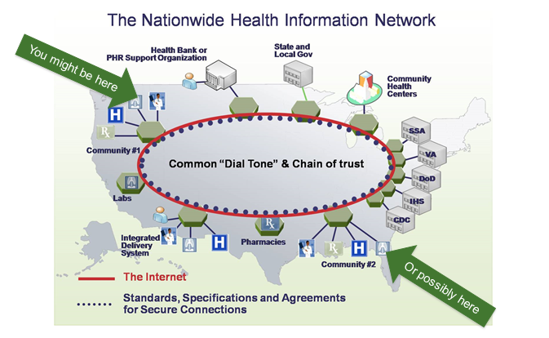
Big Picture: NwHIN
Notes:
This image depicts how the the internet connects Health Bank or PHR Support Organization, State and Local Government
This slide is from the IHE.net website – a great resource with extensive information about Health Information Exchange.
Please take a minute to look at all the components. You will notice the focus is the common tie-in utilizing internet-based technology.
We could not have embarked on this effort 10 years ago. The NwHIN is evolving as the technology grows in parallel – look what you can do on a phone today that you couldn’t in high school.

Slide 20
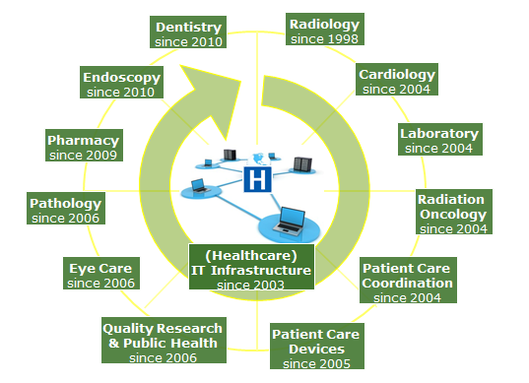
IHE Development Domains Integrating Healthcare Enterprise
Notes:
A quick note on standards development – this slide is also from IHE.net, which is one of the more pre-eminent standards authorities.
The point is, this work is not new – and it takes time to evolve. Industry representatives and those representing many healthcare disciplines are collaborating on an ongoing basis to create the structure and function to drive healthcare reform.
Complexity all of these groups need to come up with a common standard.

Slide 21
Vendor Questions to Facilitate HIE
Are there HIE capabilities within our EHR?
Privacy/security features present / supported
Form(s) of exchange
Cost of upgrading to include HIE
Maintenance costs of including HIE functionality
Timeframe for availability if not available now
Notes:
Most vendors have incorporated the functionality of electronic health information exchange into their Electronic Health Record (EHR). To determine if an EHR is ready to exchange information, check with the vendor regarding your system’s capabilities.
Ask:
What privacy and security features does your product currently provide and support?
What form(s) of exchange does your EHR support? Which protocols? Direct and Connect?
What are the costs associated with upgrading to include HIE functionality within our practice’s EHR?
What are the maintenance and monthly costs of adding this functionality?
If the vendor does not currently offer HIE functionality, when do they plan to integrate HIE into the EHR?
http://healthit.gov/providers-professionals/health-information-exchange/getting-started-hie

Slide 22
Interoperability & HIE
Review of HIE:
HIE the verb – the Exchange of Health Information
HIE the nouns:
(HIE) Health Information Exchanges
(RHIO) Regional Health Information Organizations
(ACO) Accountable Care Organizations
(PCMH) Patient Centered Medical Homes
Notes:
So to review some basic terms –
HIE is used as a verb describing the process of the exchange of Health information. It is also used as noun that refers to the entities that accomplish HIE.
A Regional Health Information Organization (RHIO, pronounced rio), is a multi-stakeholder organization that facilitates the transfer of healthcare information electronically across organizations and among stakeholders in a particular region. RHIOs also support using clinical data for research and quality assessment and improvement. RHIO stakeholders include smaller clinics, hospitals, medical societies, major employers and payers.
http://en.wikipedia.org/wiki/Regional_Health_Information_Organization
An Accountable Care Organization (ACO) ties provider reimbursements to quality metrics and healthcare cost reductions. A group of coordinated health care providers forms an ACO, which then provides care to a group of patients. http://en.wikipedia.org/wiki/Accountable_care_organization
A Patient Centered Medical Home (PCMH) provides comprehensive and continuous medical care to patients with the goal of obtaining maximized health outcomes through providing coordinated care through team-based models.
http://en.wikipedia.org/wiki/Medical_home

Slide 23
New Term Spreading Like WildFHIR
Fast Healthcare Interoperable Resource
FHIR combines the best features of: HL7v2, HL7v3, CDA
FHIR leverages latest web service technologies
FHIR utilizes “REST” in contrast to “SOAP” web services
FHIR’s modular components bring practical solutions
HL7 International: Draft Standard for Trial Use (DSTU)
Notes:
F – H – I – R …this new term is spreading like Wildfire! HL7 Fast Healthcare Interoperable Resource is abbreviated: F-H-I-R and is pronounced, “Fire.” It combines the best features of HL7 version 2 and HL7 version 3 and the Clinical Document Architecture, or CDA and leverages the latest web service technologies.
In a shift from the majority of IHE profiles based on SOAP, FHIR utilizes a software architectural style known as RESTful web services. This modular approach helps bring practical solutions to clinical and administrative problems
HL7 International makes FHIR freely available and improvements to the standard, along with public comment periods, are still being made. These new and emerging standards will make FHIR easier to implement, yet will still be based on exiting CDA models.

Slide 24
Future of HIE
Seamless secure exchange of information among diverse systems (global)
Providers have instant access to patient key data
Blurred lines between the hospital and vendor
NwHIN infrastructure operating
State Designated Entities (SDE’s) will evolve into regional entities (not necessarily be governed by geographical boundaries)
Notes:
An overall goal is to reach a system of seamless secure information exchange across diverse systems at the regional, national and eventually global level. Then providers will have instant access to key patient data.
In the future, HIE’s as we know them today will cease to exist, because the lines will blur between the Hospital and Vendor, and we will take a lot of the NwHIN infrastructure for granted. State Designated Entities (SDE’s) will evolve into the type of Regional entities that best fits the community. This will not necessarily be governed by geographical boundaries.

Slide 25
In Summary
Defined HIE and Interoperability
Benefits and Risks of HIE
Basic terminology of interoperability & data exchange
Highlighted the structure of HIE entities
Shared some future expectations for HIE
Notes:
In this unit we
Defined HIE and Interoperability
Benefits and Risks of HIE
Basic terminology of interoperability & data exchange
Highlighted the structure of HIE entities
Shared some future expectations for HIE

Slide 26
References
References
Health information exchange. (2017). Retrieved 2017, from Wikipedia website.
Minnesota e-Health. (2017). Retrieved 2017, from Minnesota e-Health website.
Connect Open Source. (2017). FAQ. Retrieved 2017, from Connect Open Source website.
Interoperability Basics. (n.d.). Retrieved 2017, from ONC website.
Getting Started with HIE. (n.d.). Retrieved 2017, from ONC website.
Regional Health Information Organization. (2017). Retrieved 2017, from Wikipedia website.
Accountable care organization. (2017). Retrieved 2017, from Wikipedia website.
Medical home. (2017). Retrieved 2017, from Wikipedia website.
Notes:
No audio.

Slide 27
Health Information Exchange Lecture b
This material was developed by Normandale Community College, funded by the Department of Health and Human Services, Office of the National Coordinator for Health Information Technology under Award Number 90WT0003.
Notes:
No audio.

